Slide 1
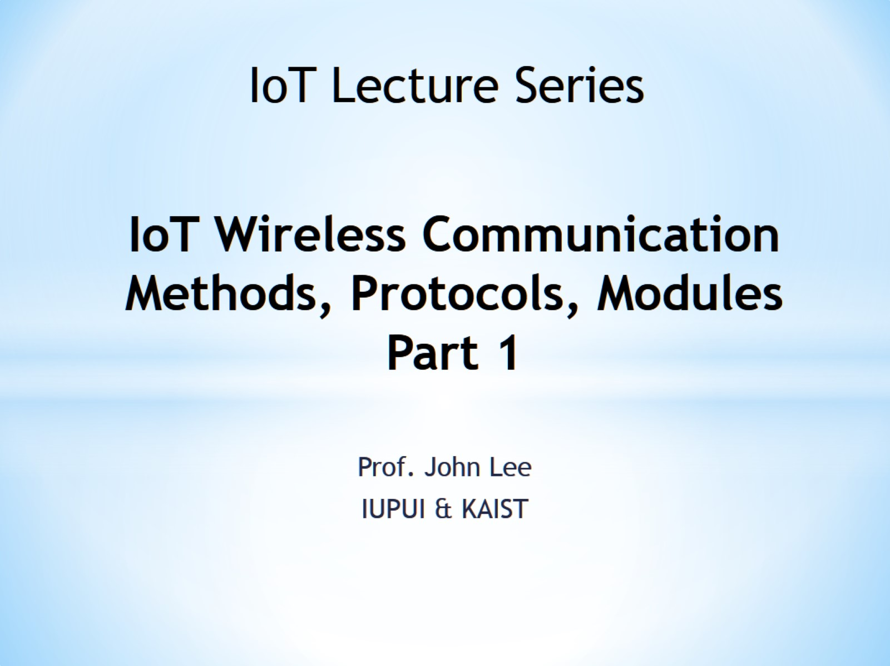
IoT Wireless Communication Methods, Protocols, Modules Part 1

Slide 2
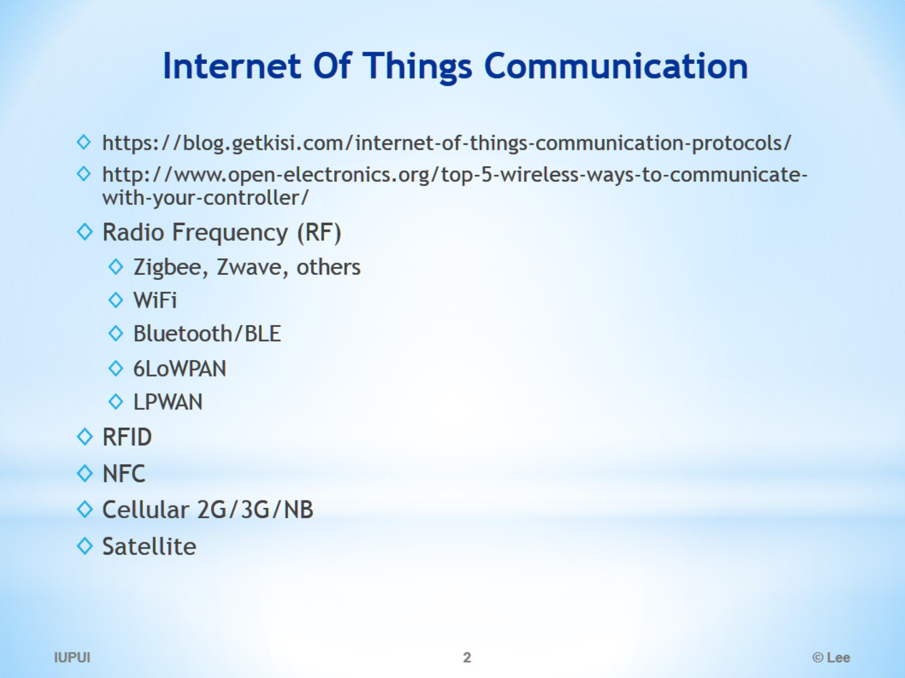
Internet Of Things Communication

Slide 3
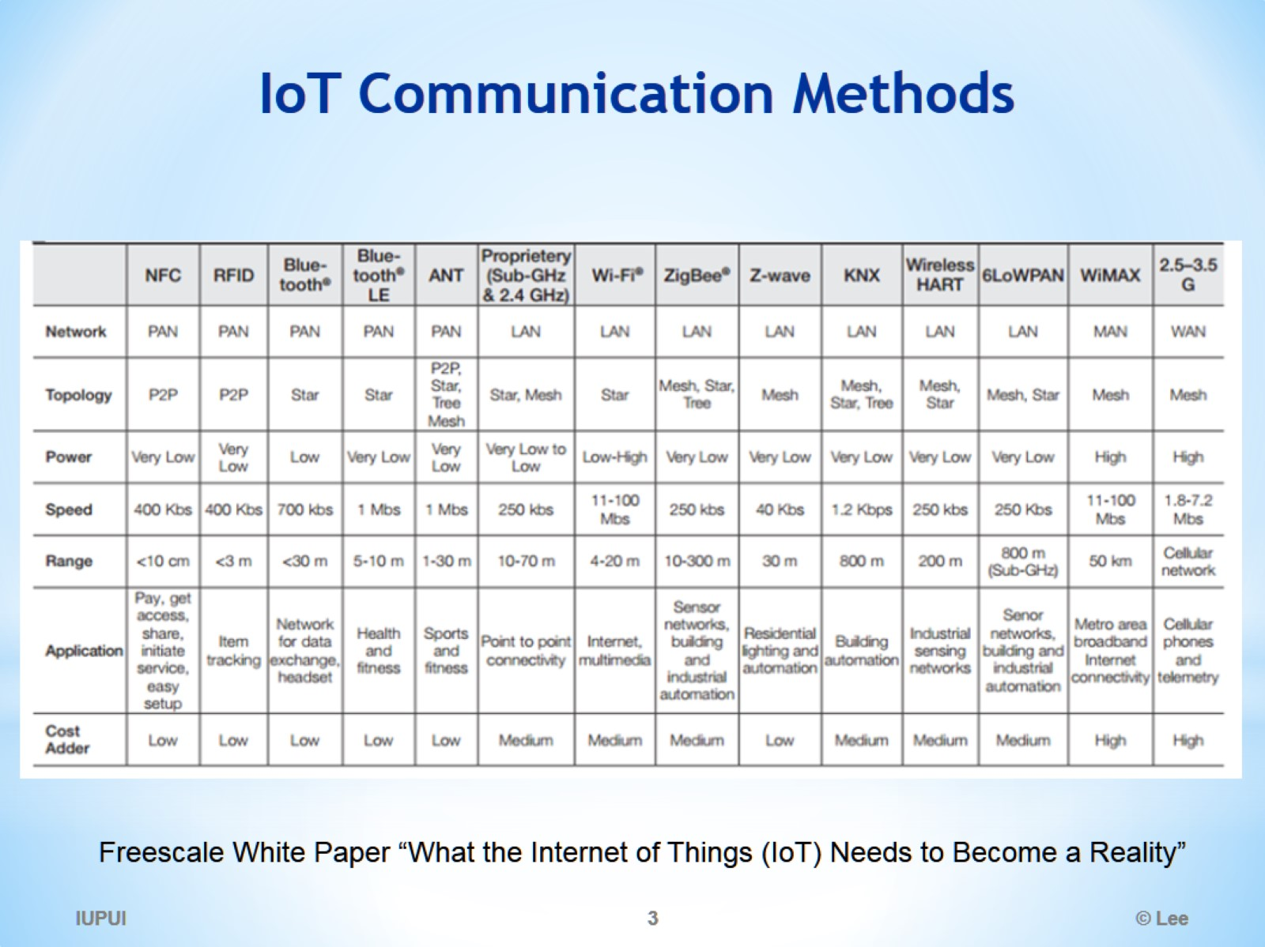
IoT Communication Methods

Slide 4
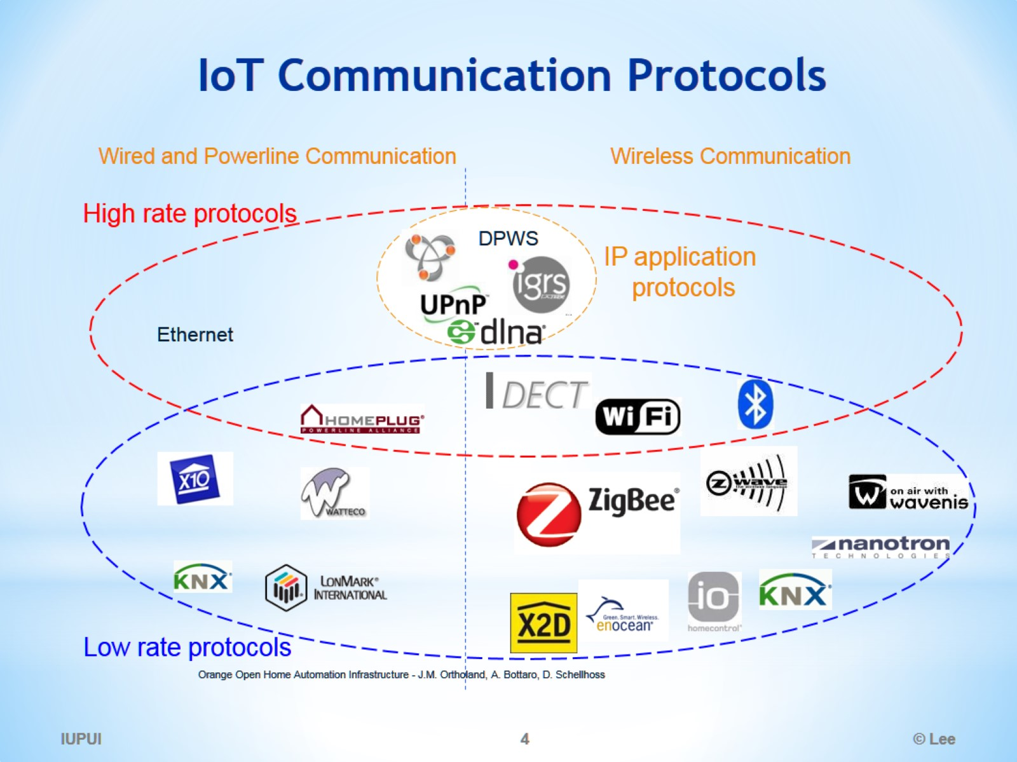
IoT Communication Protocols

Slide 5
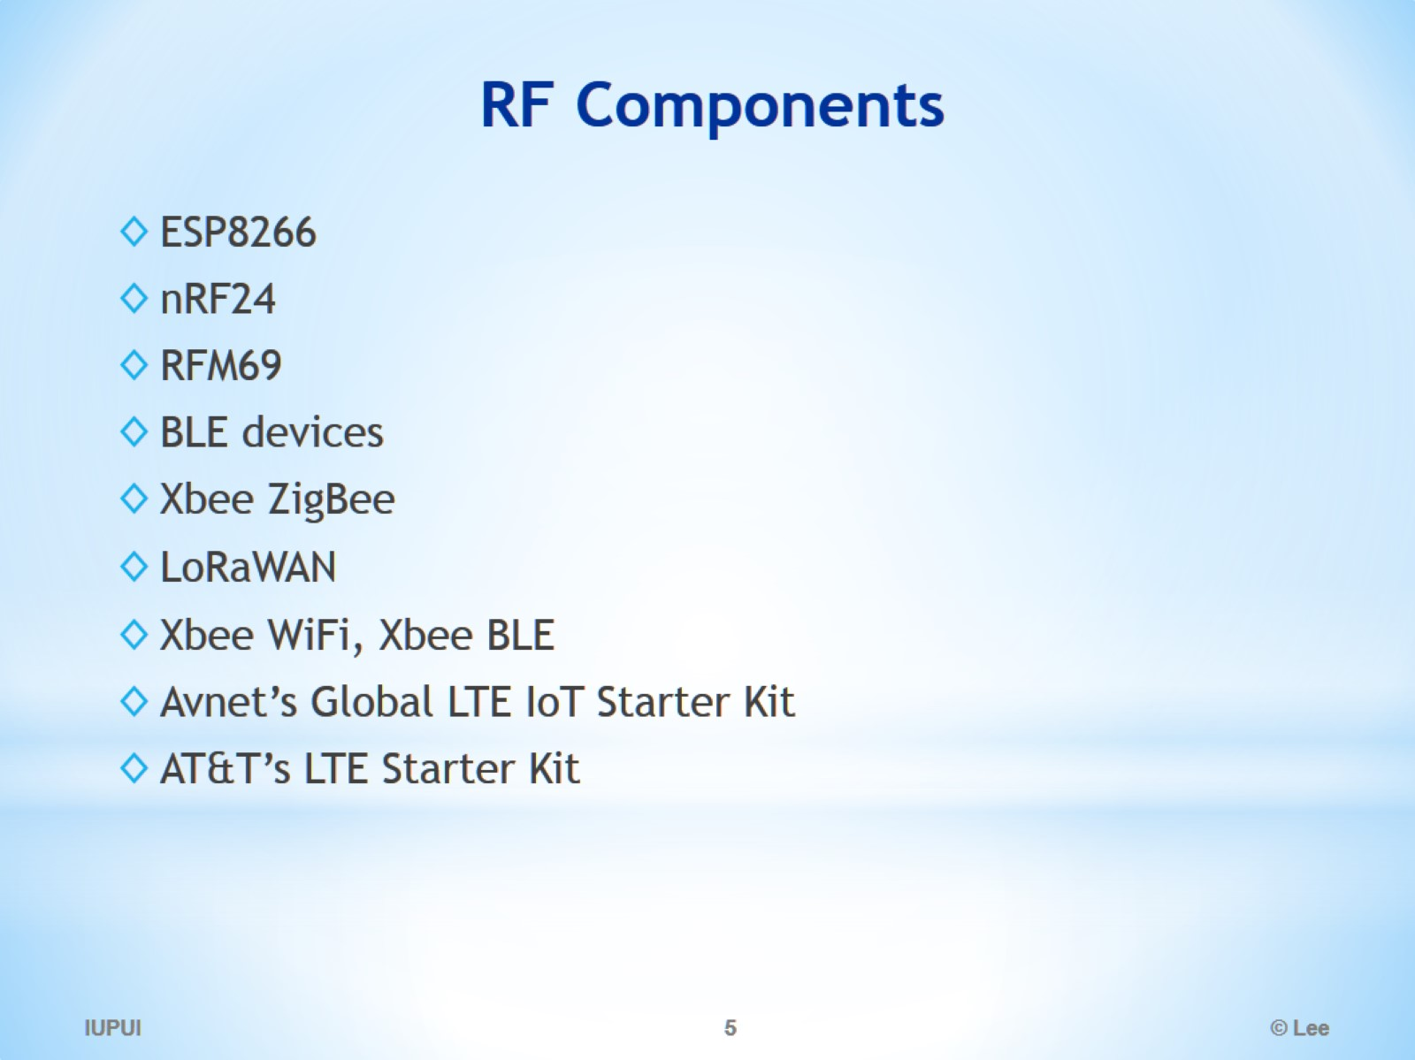
RF Components

Slide 6
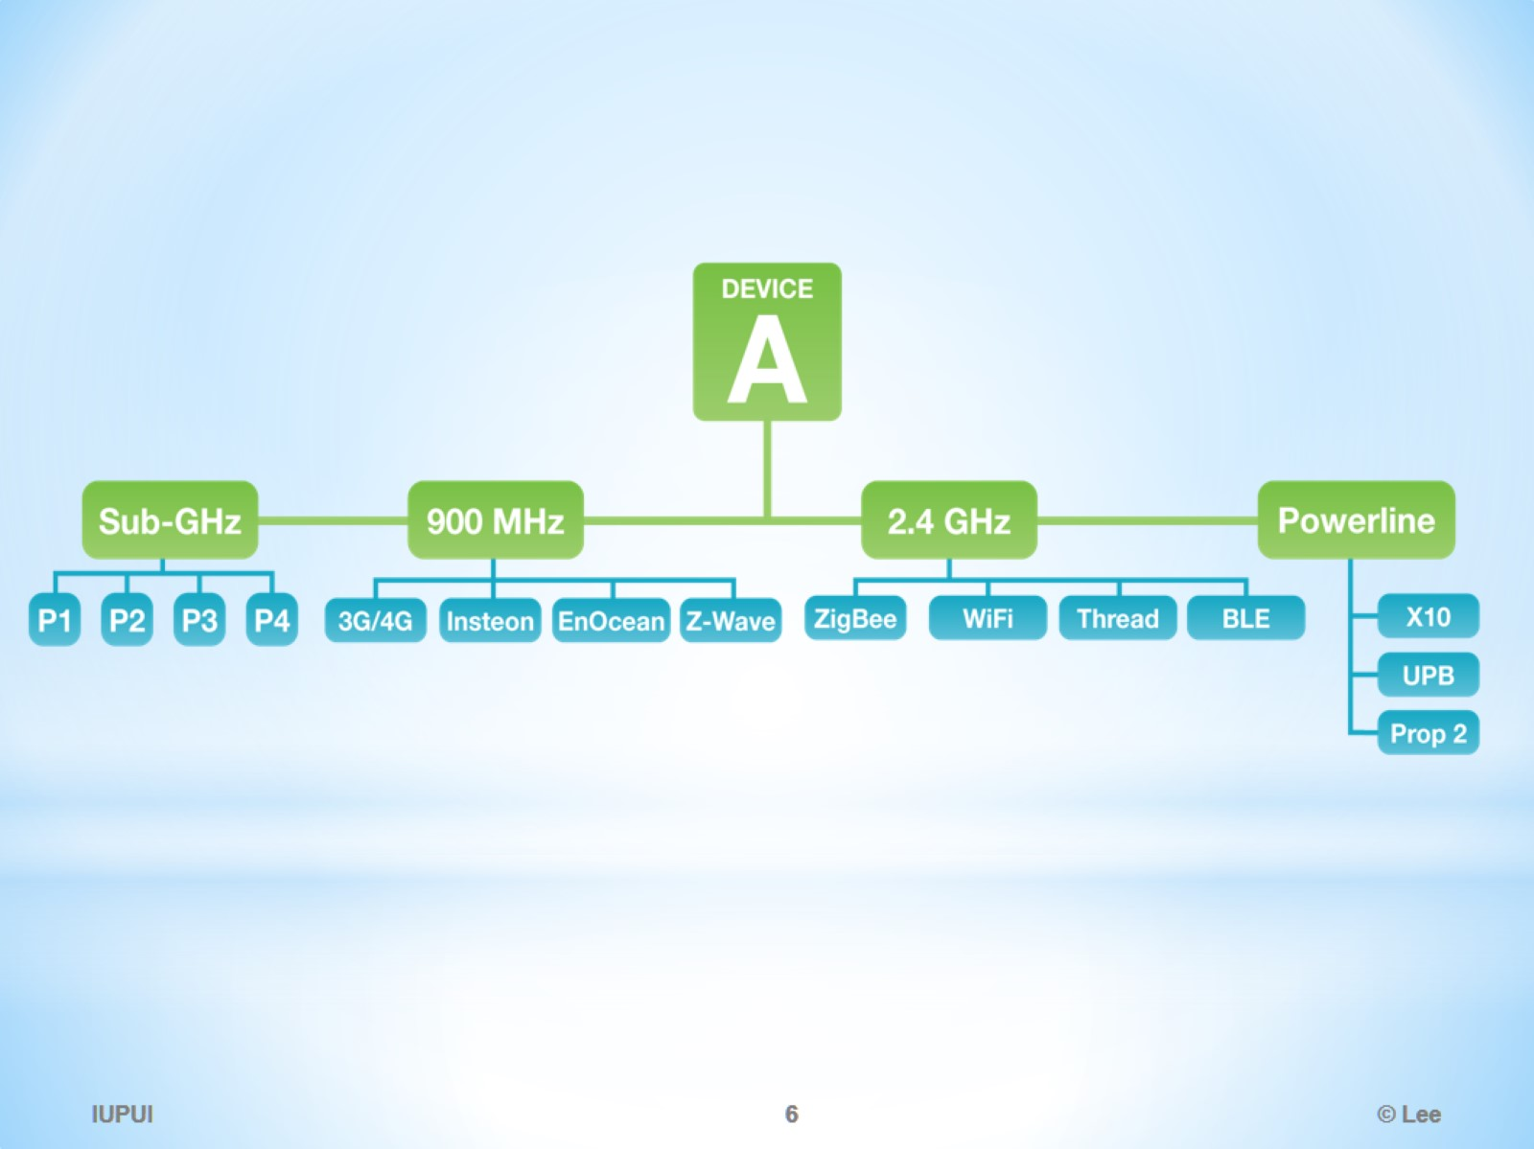

Slide 7
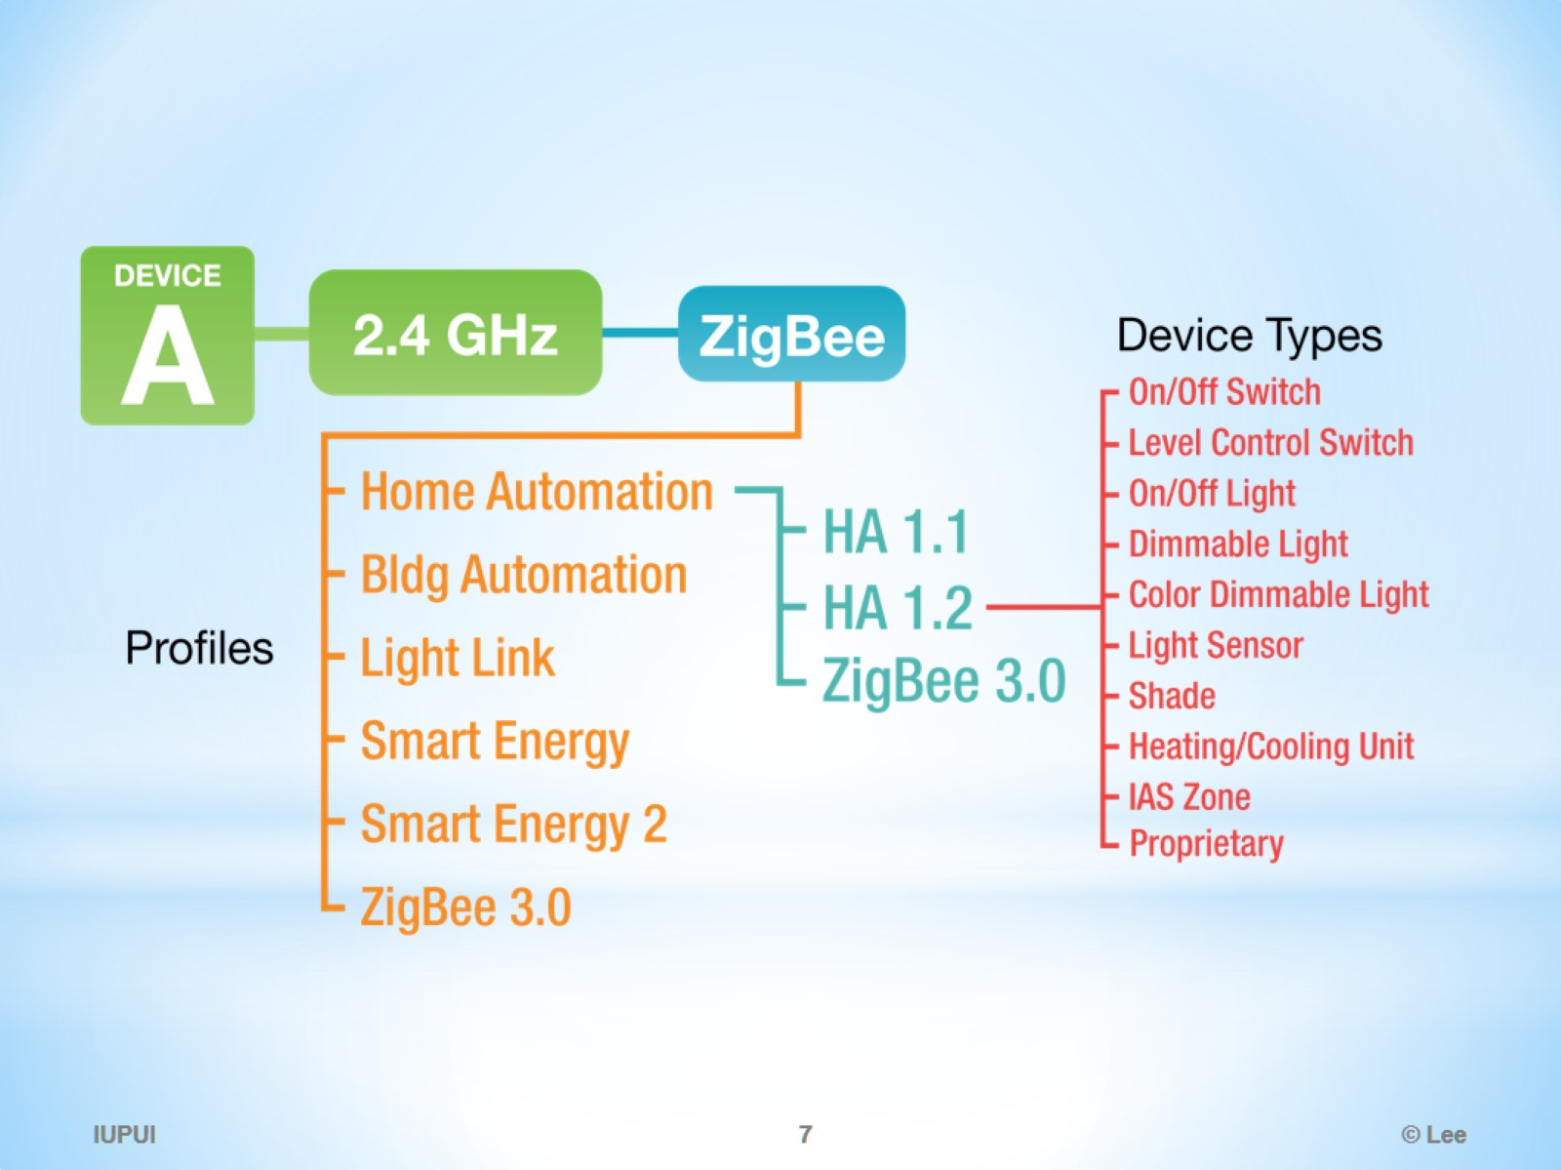

Slide 8
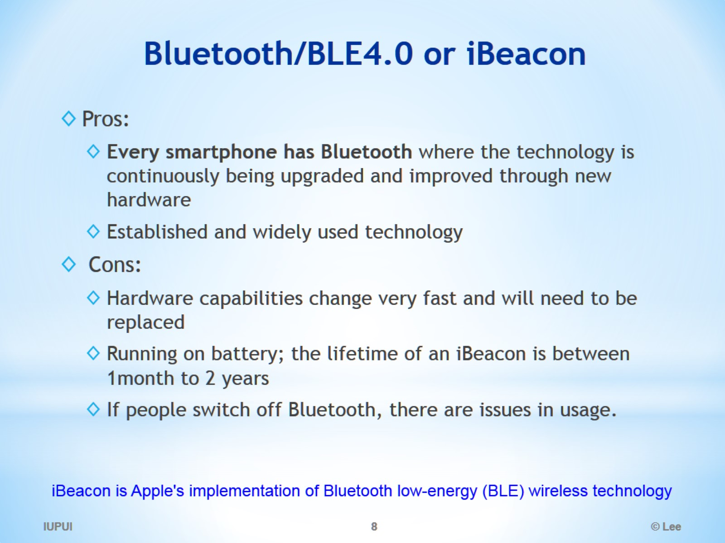
Bluetooth/BLE4.0 or iBeacon

Slide 9
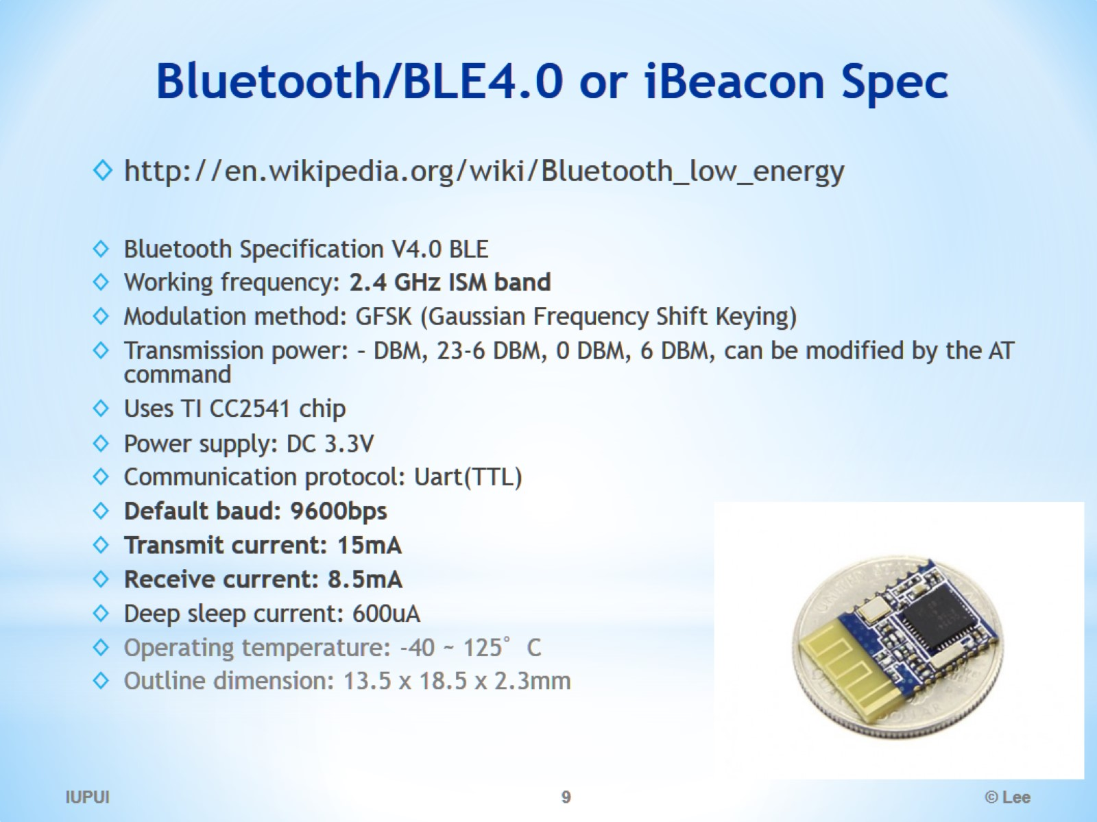
Bluetooth/BLE4.0 or iBeacon Spec

Slide 10
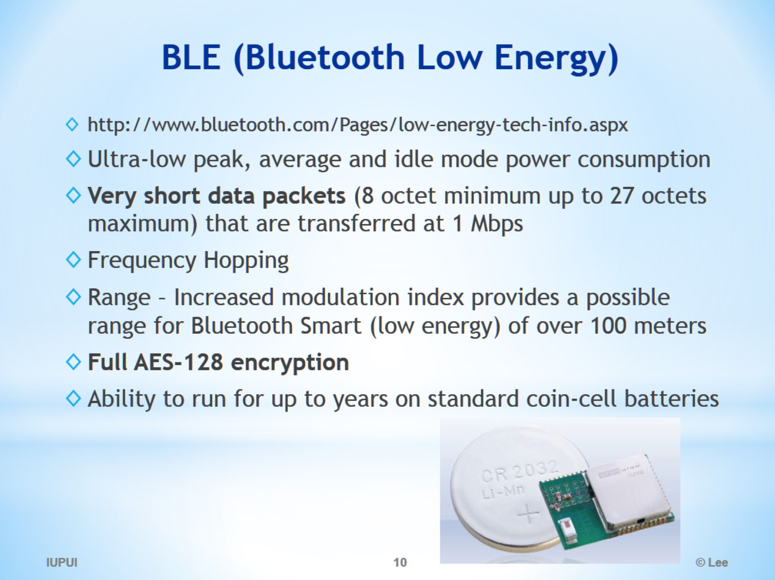
BLE (Bluetooth Low Energy)

Slide 11
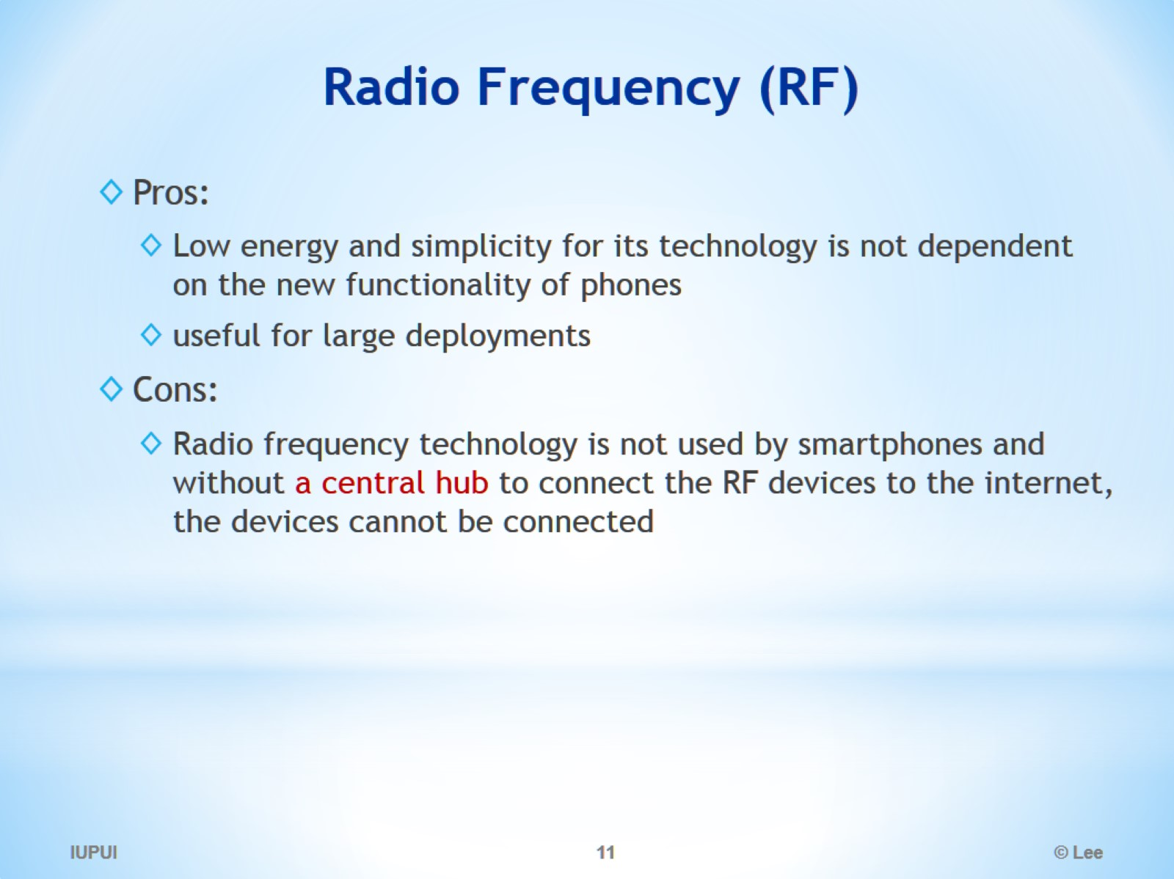
Radio Frequency (RF)

Slide 12
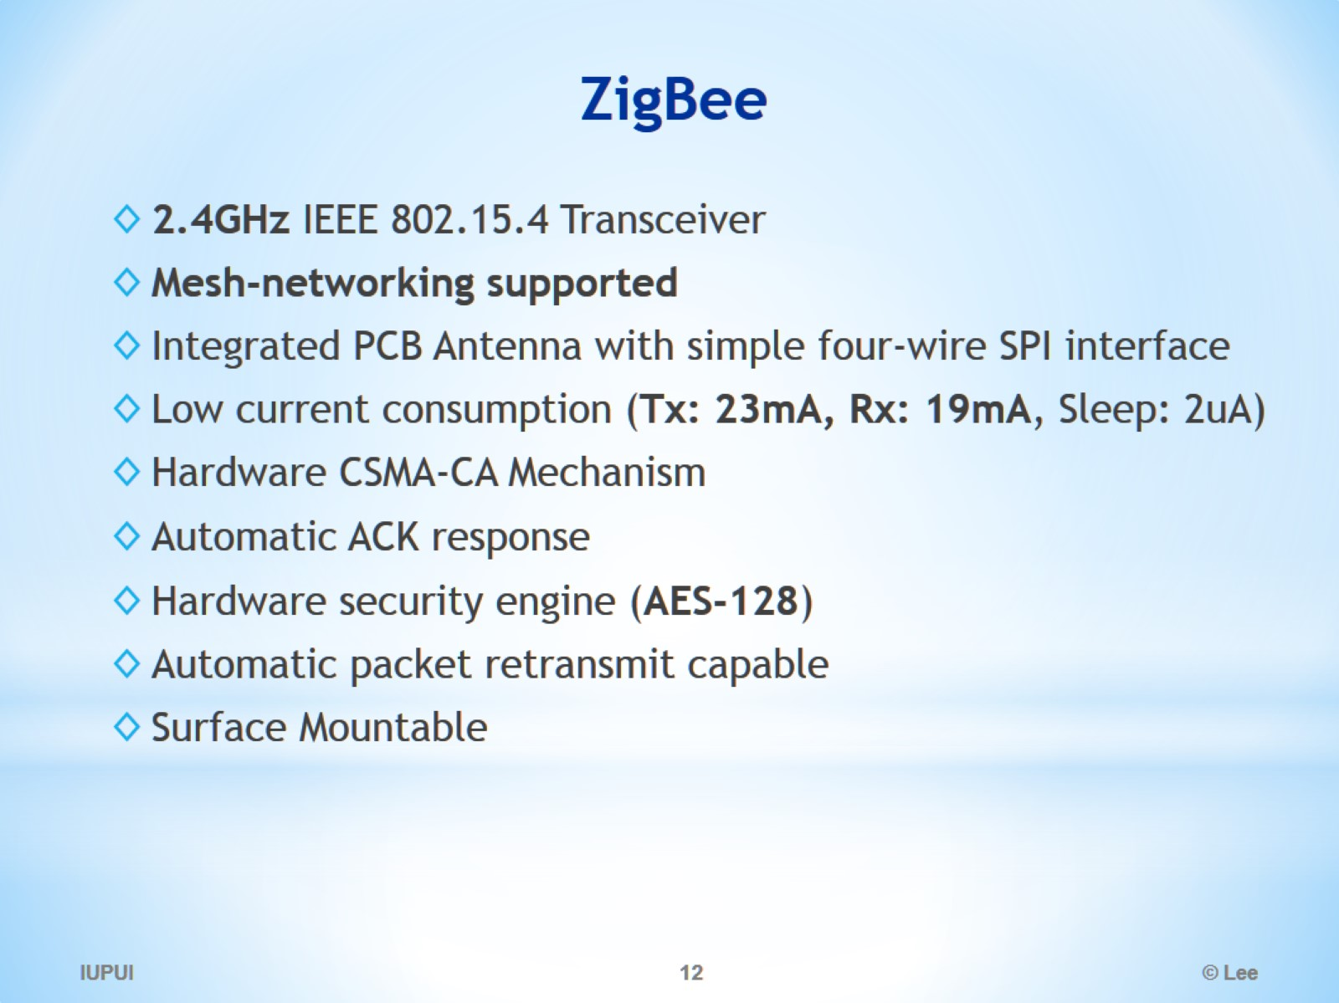
ZigBee

Slide 13
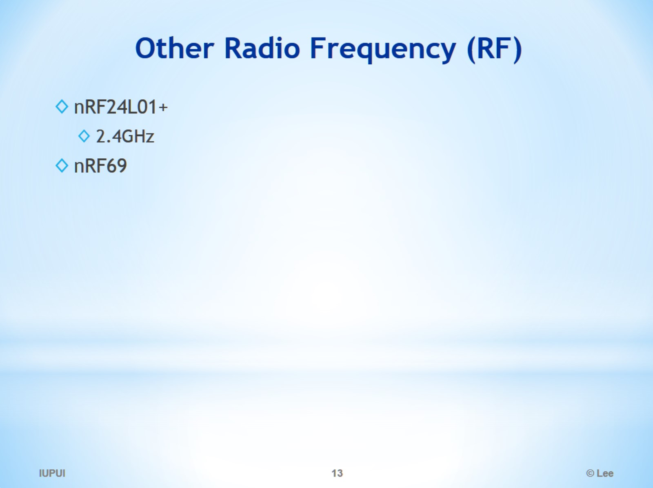
Other Radio Frequency (RF)

Slide 14
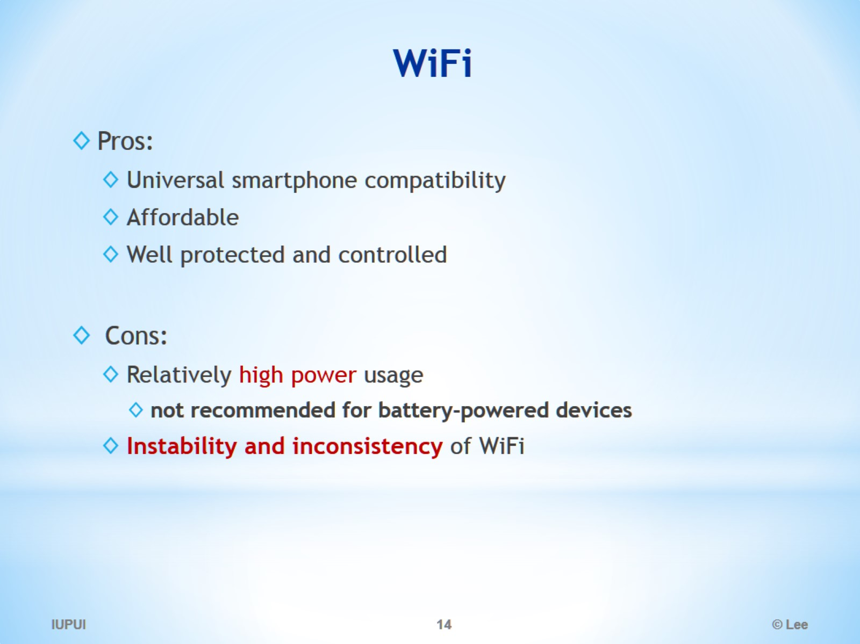
WiFi

Slide 15
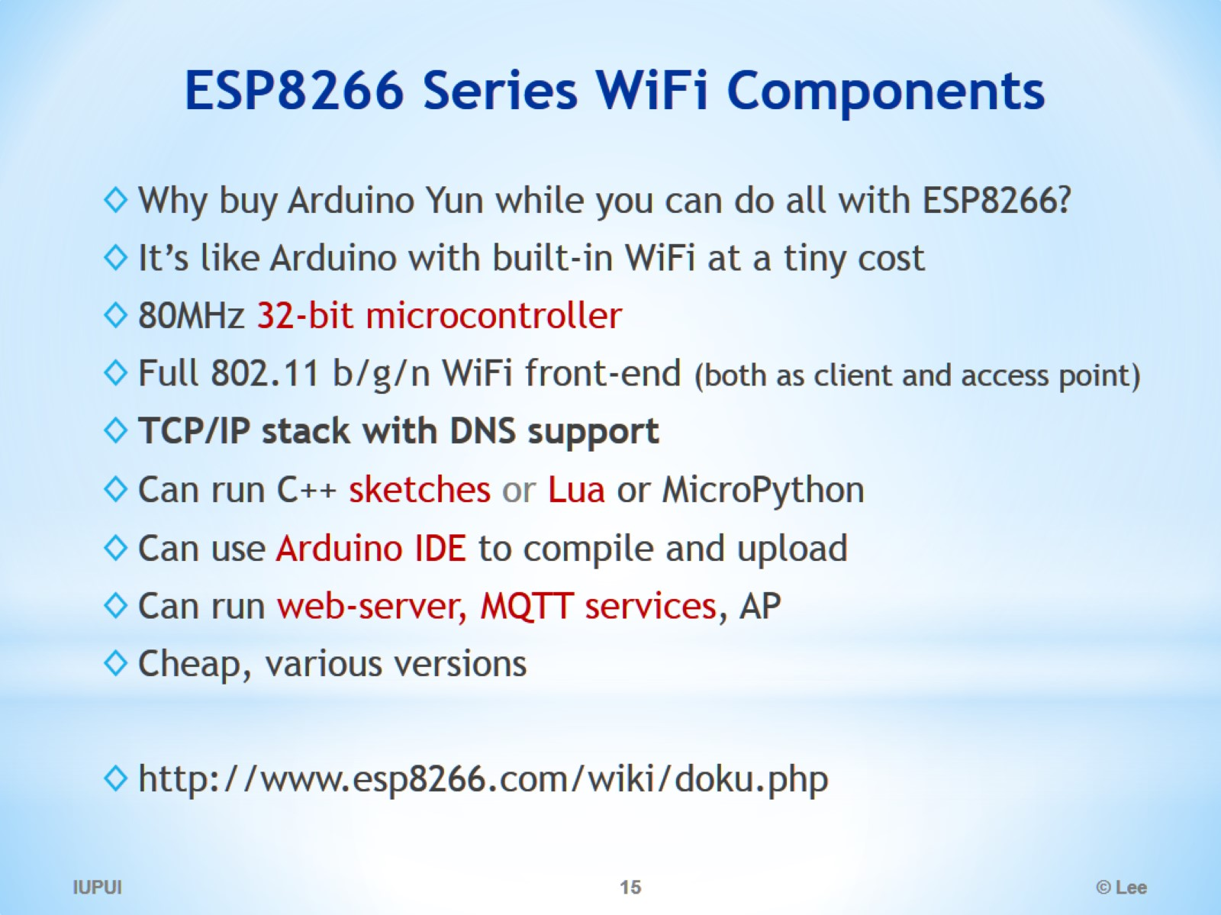
ESP8266 Series WiFi Components

Slide 16
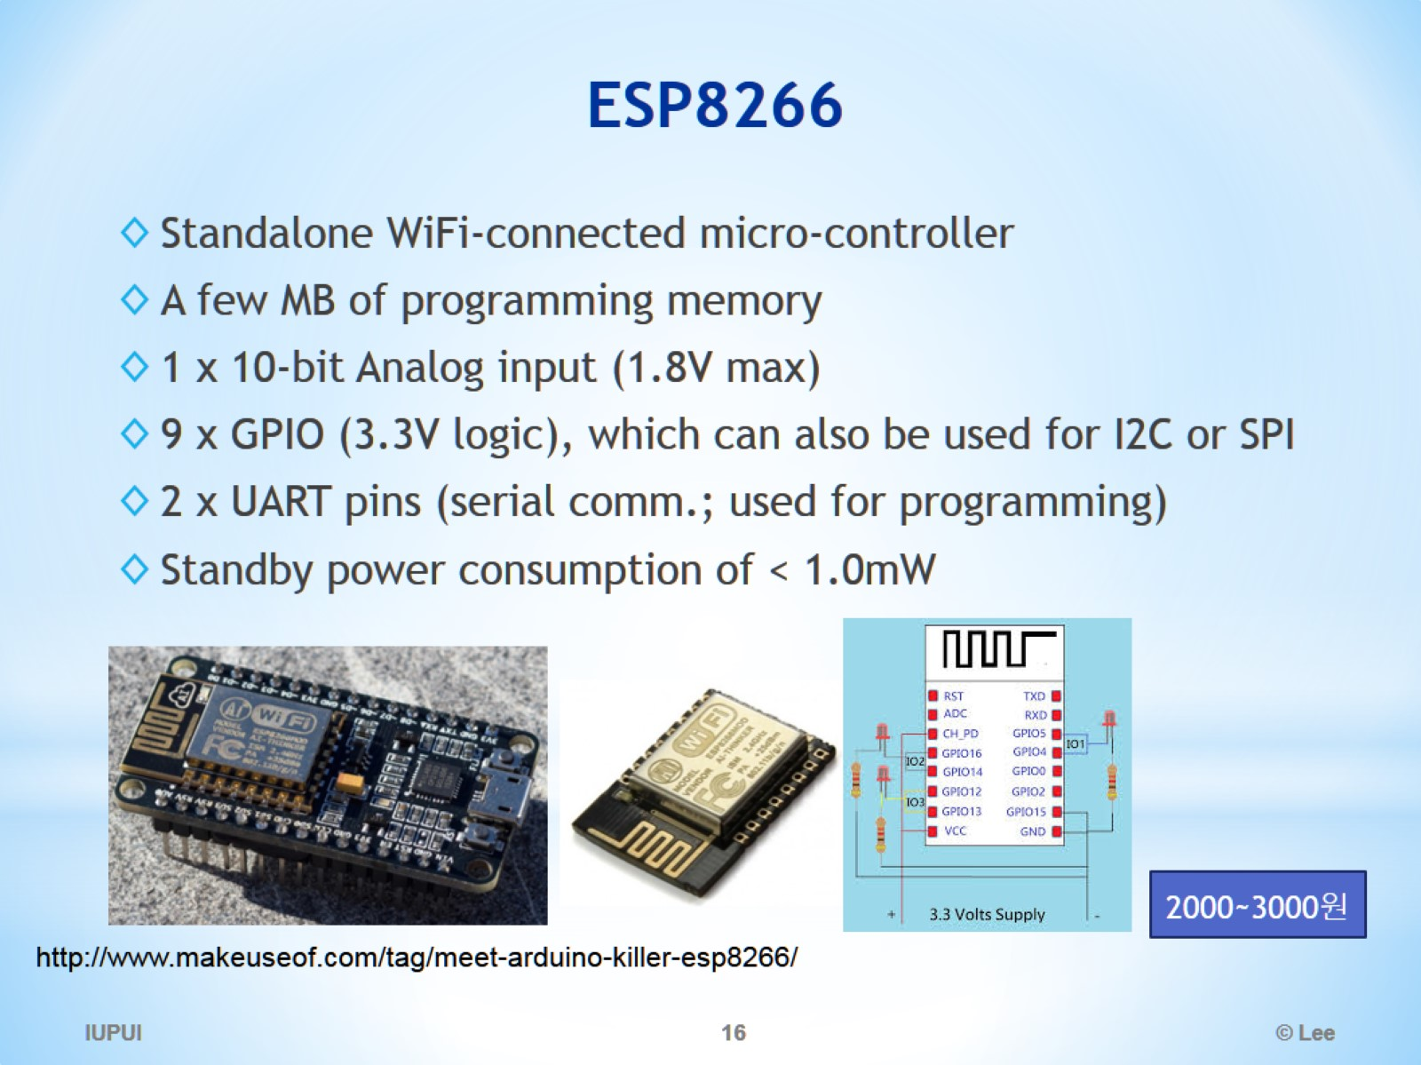
ESP8266

Slide 17
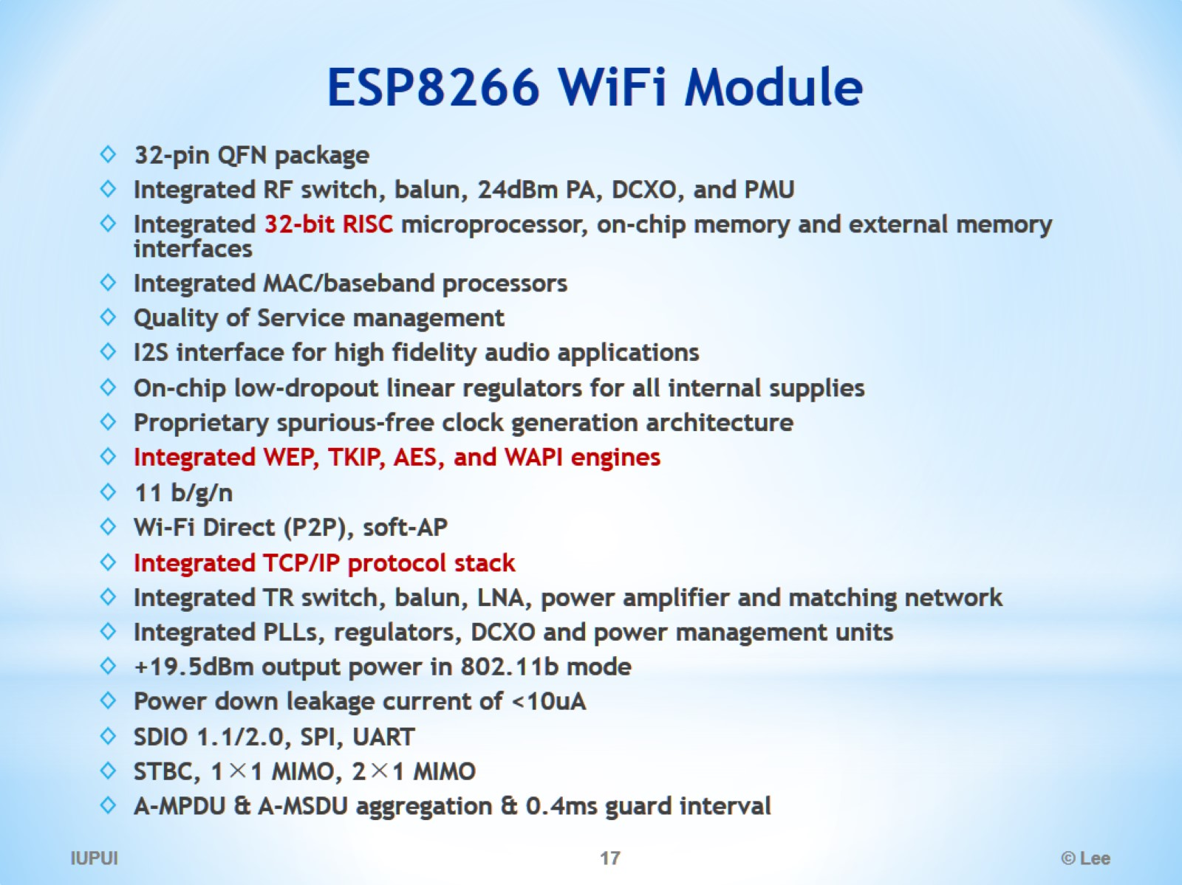
ESP8266 WiFi Module

Slide 18
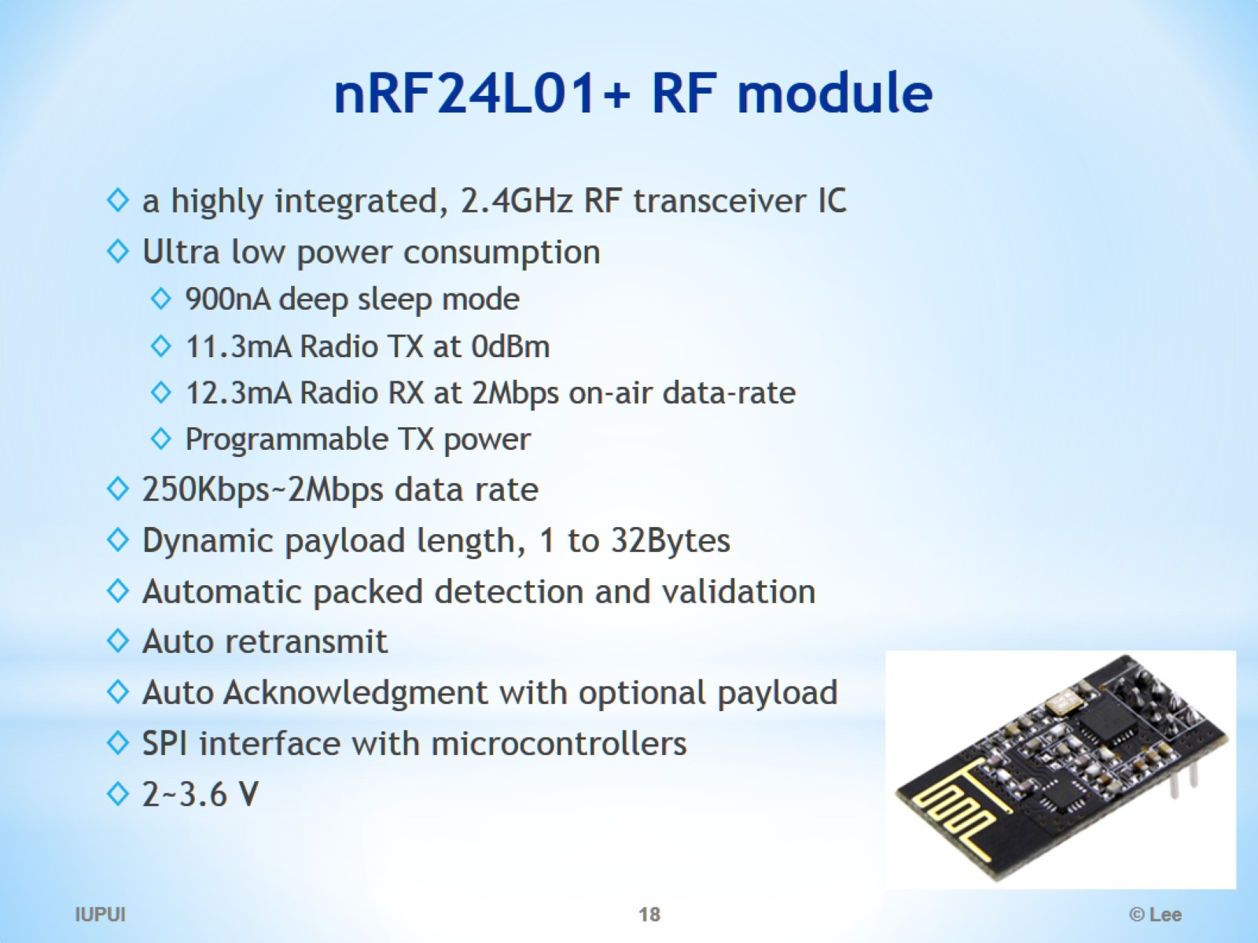
nRF24L01+ RF module

Slide 19
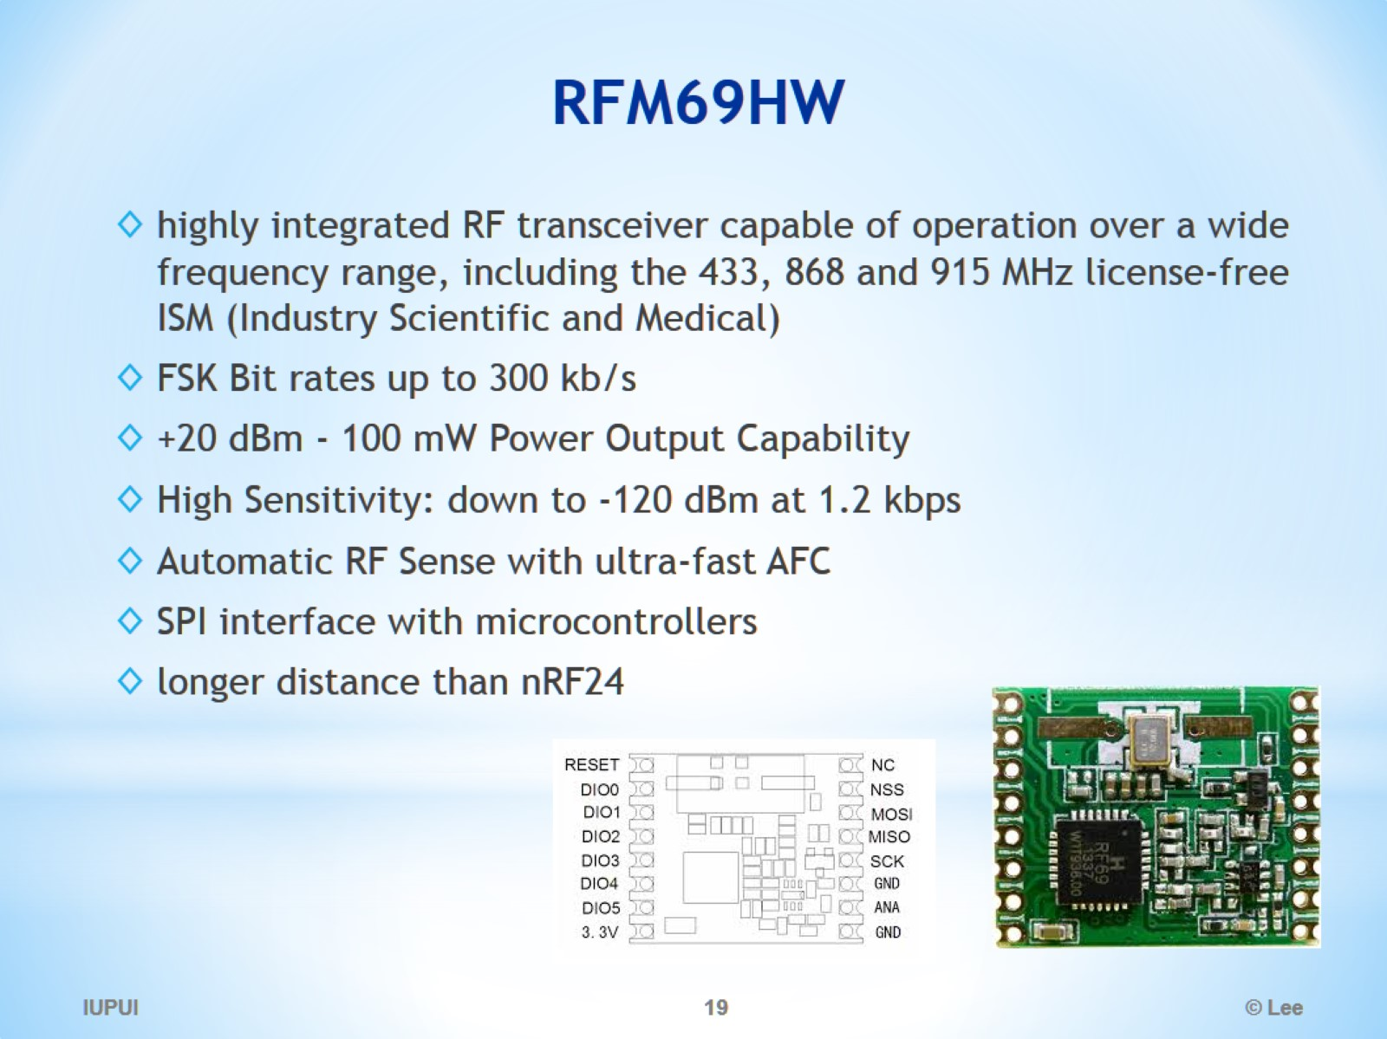
RFM69HW

Slide 20
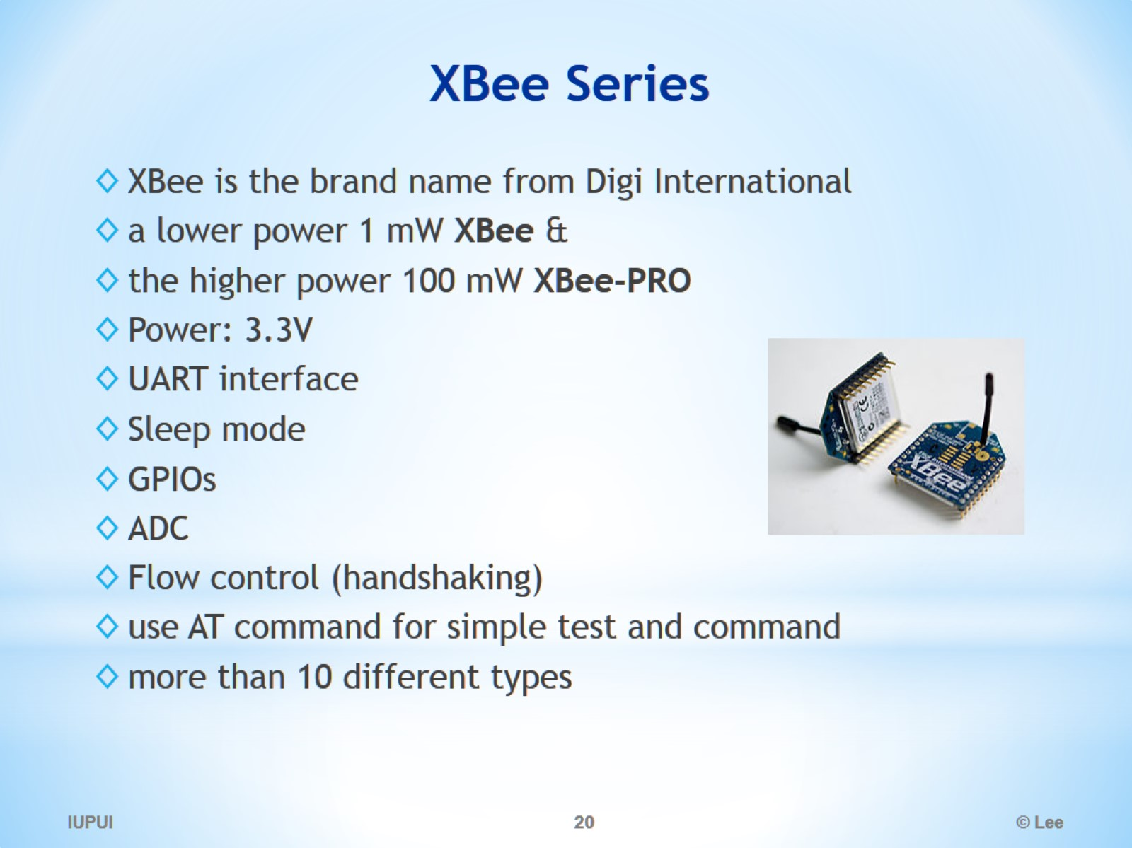
XBee Series

Slide 21
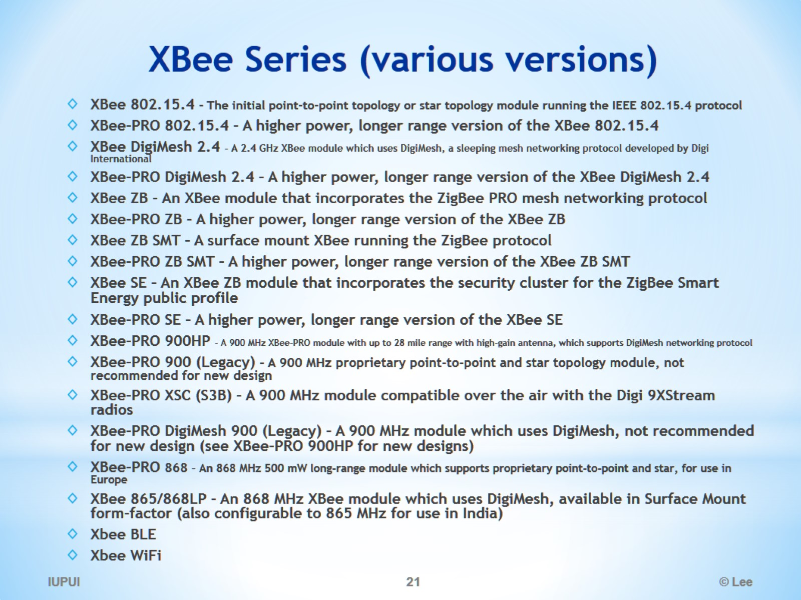
XBee Series (various versions)

Slide 22
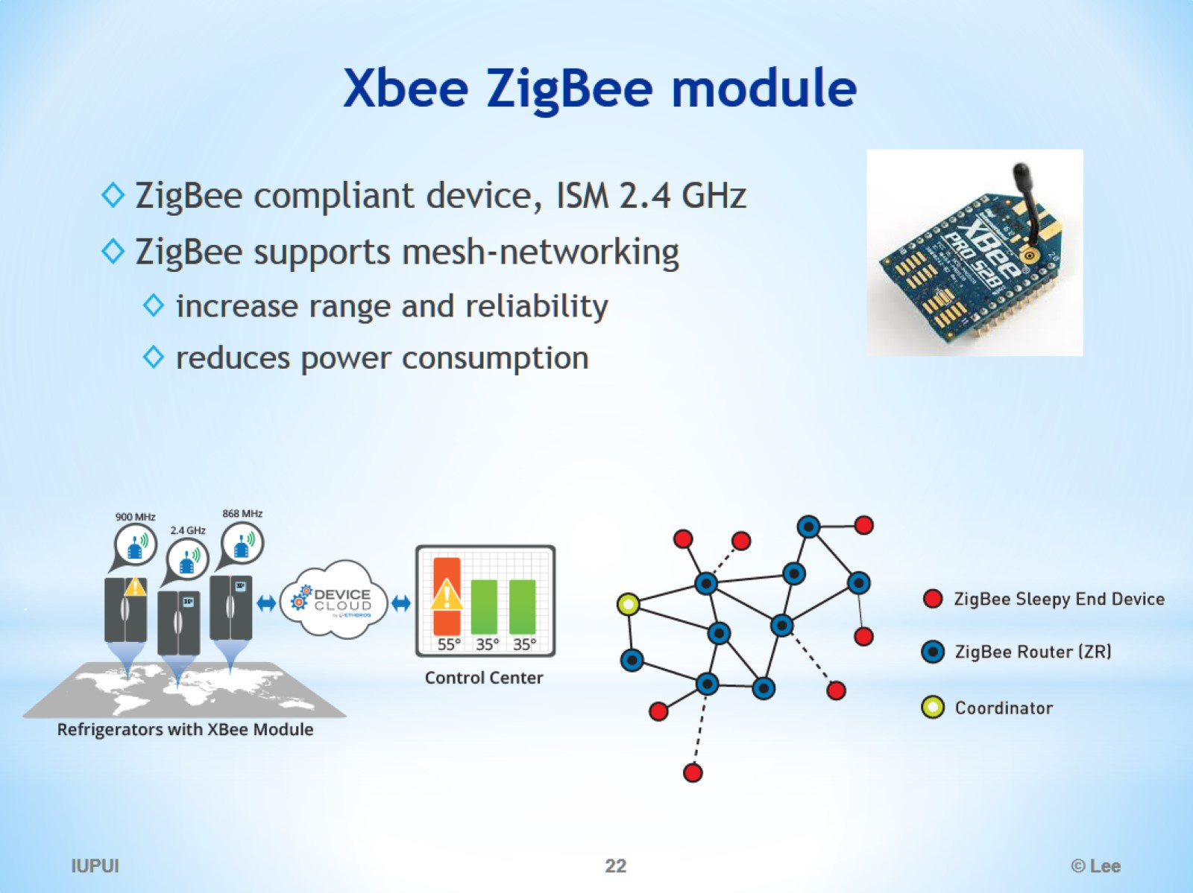
Xbee ZigBee module

Slide 23
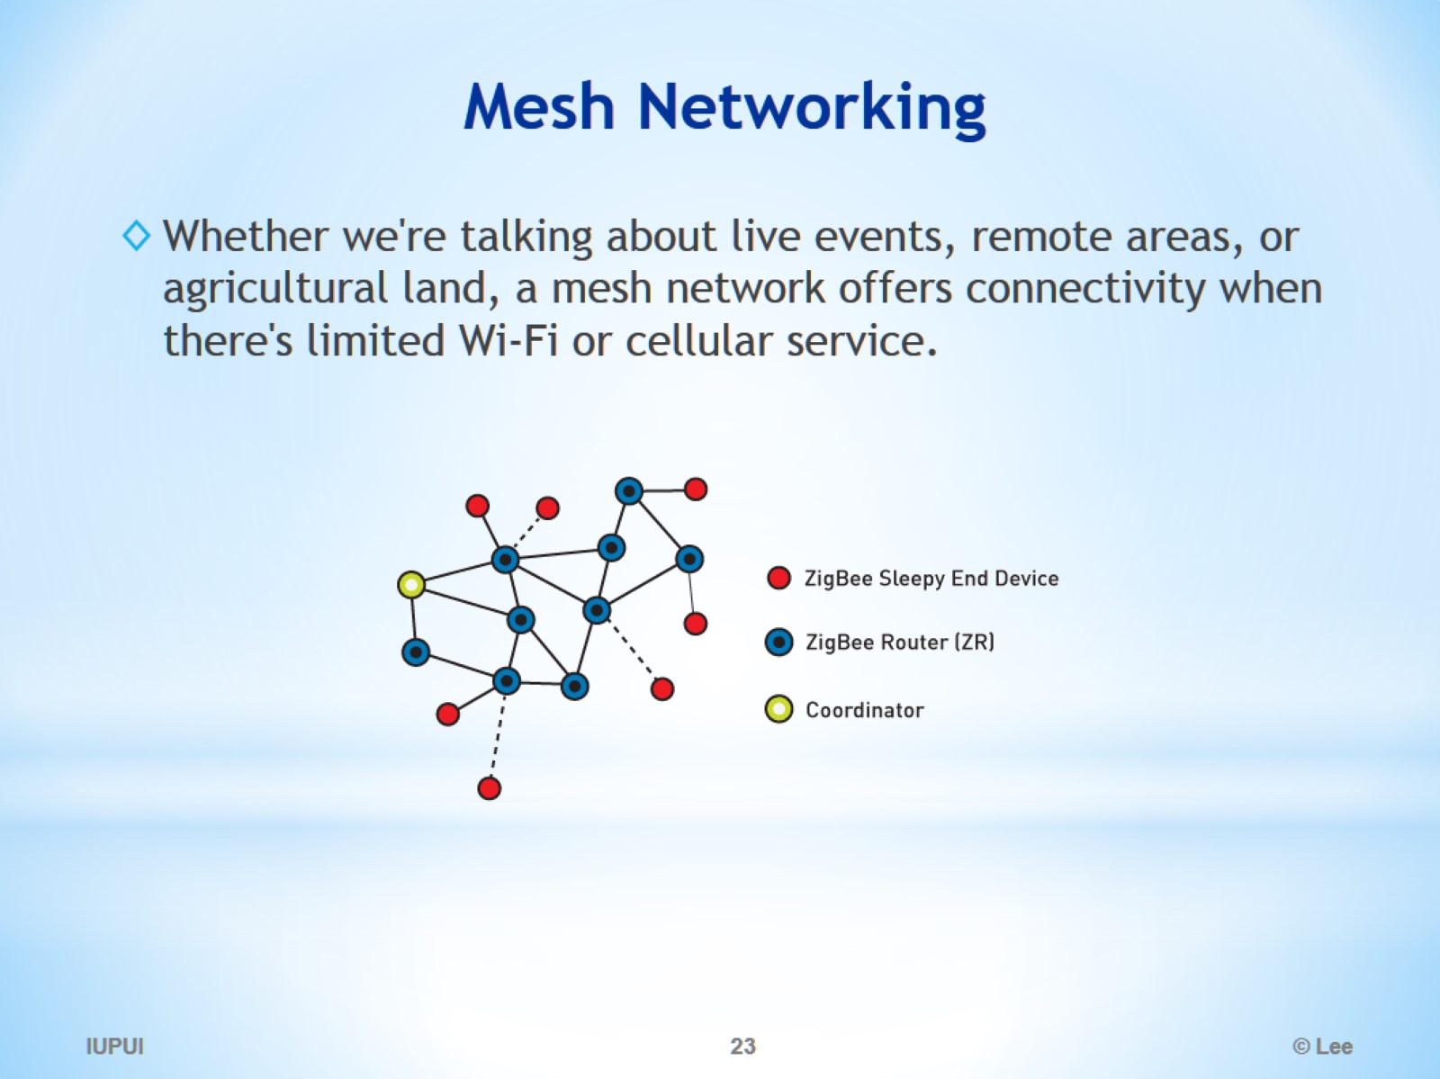
Mesh Networking

Slide 24
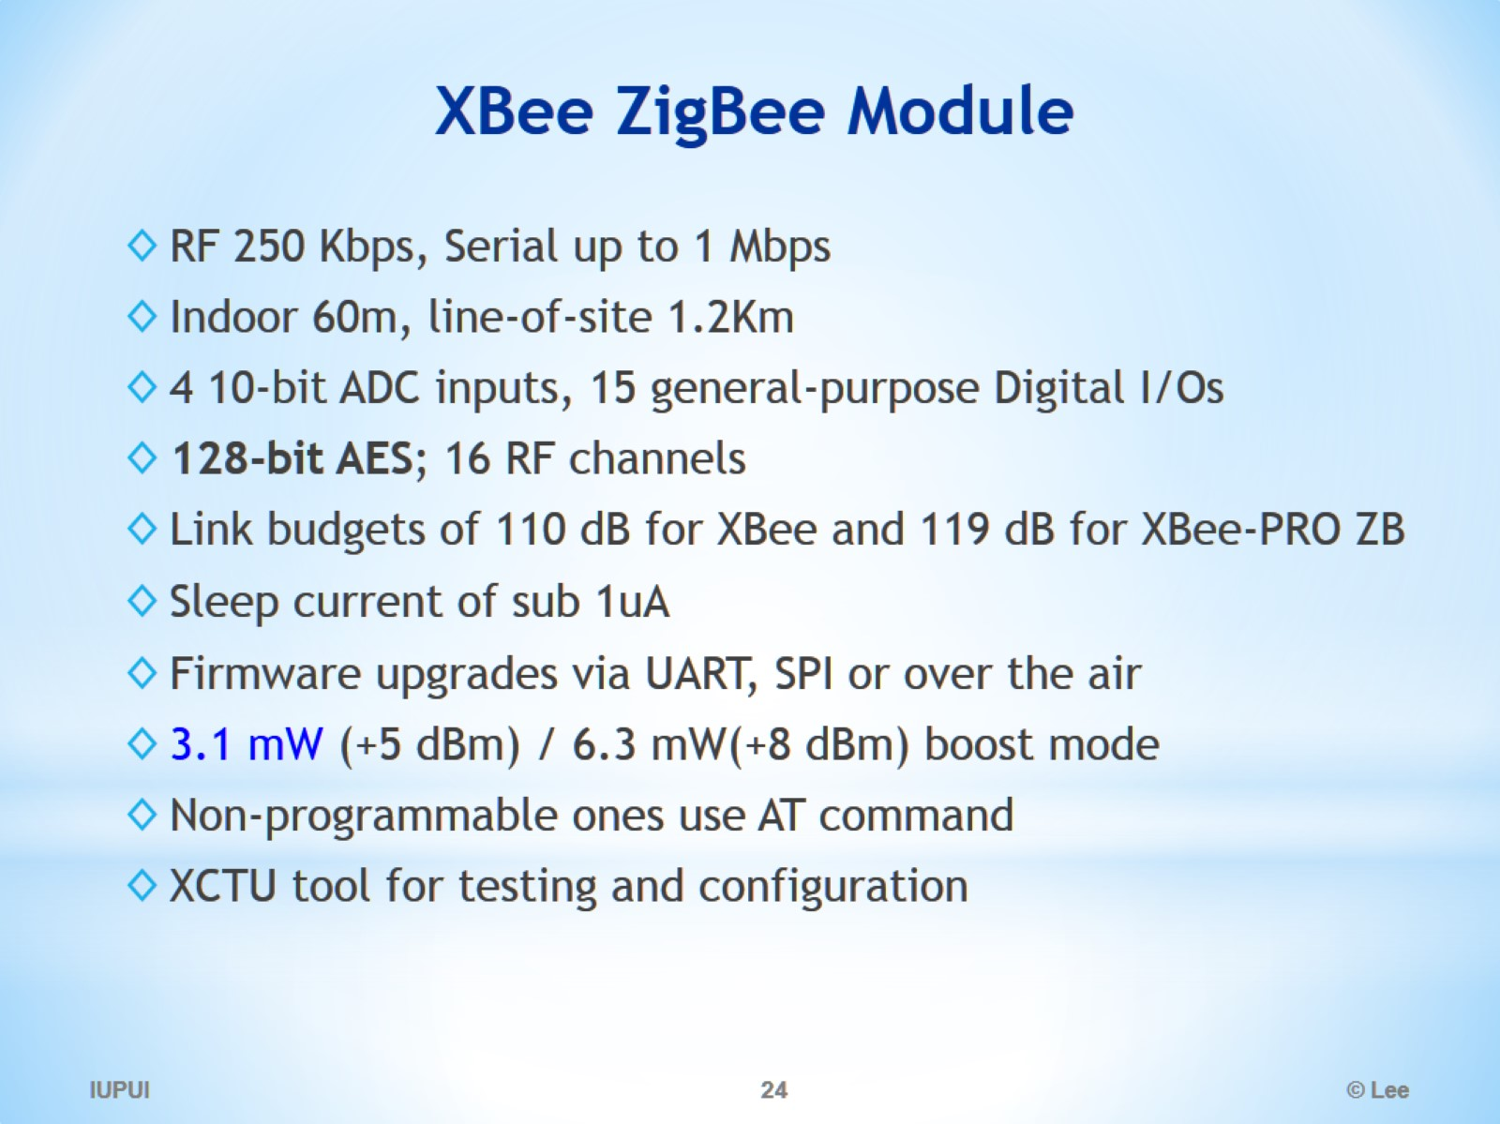
XBee ZigBee Module

Slide 25
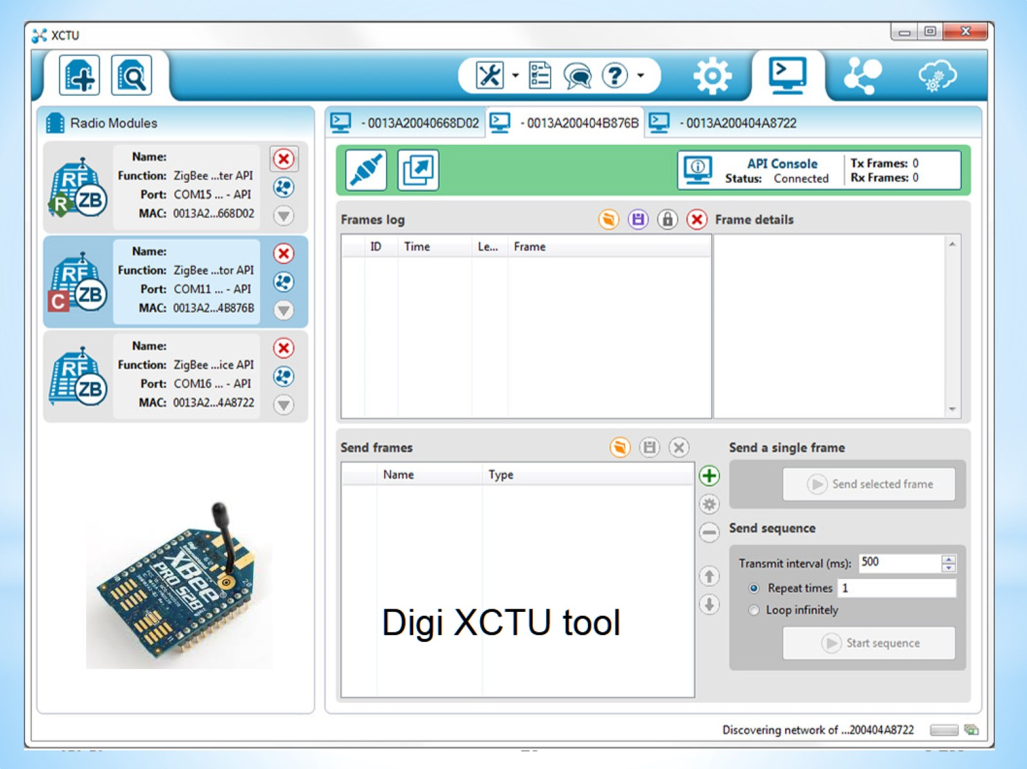
XCTU

Slide 26
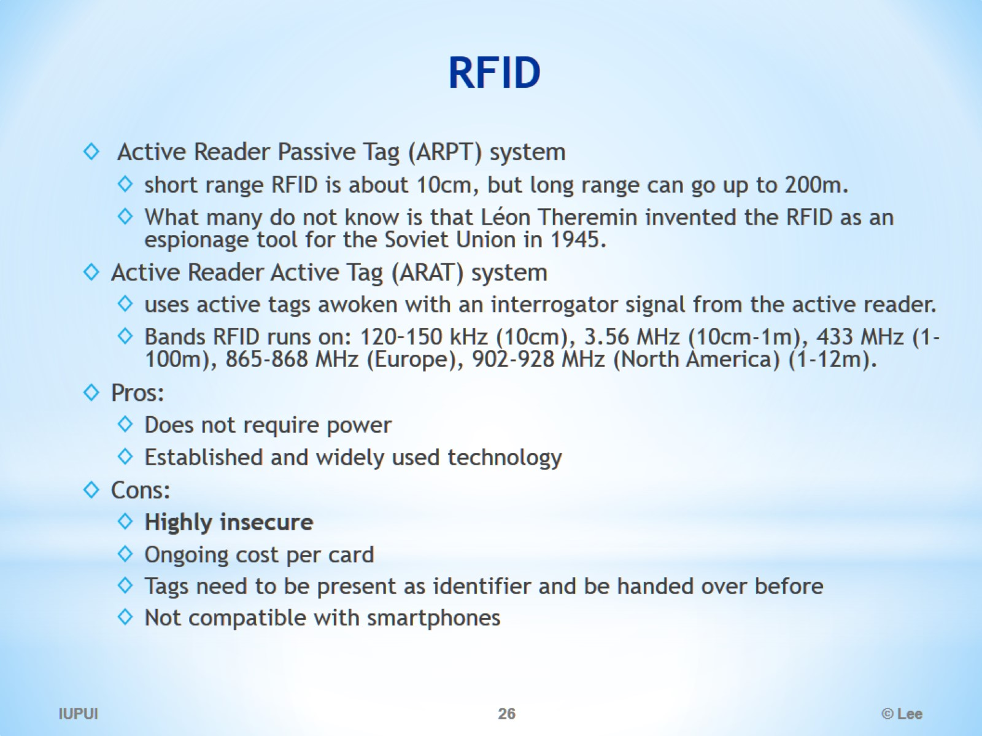
RFID

Slide 27
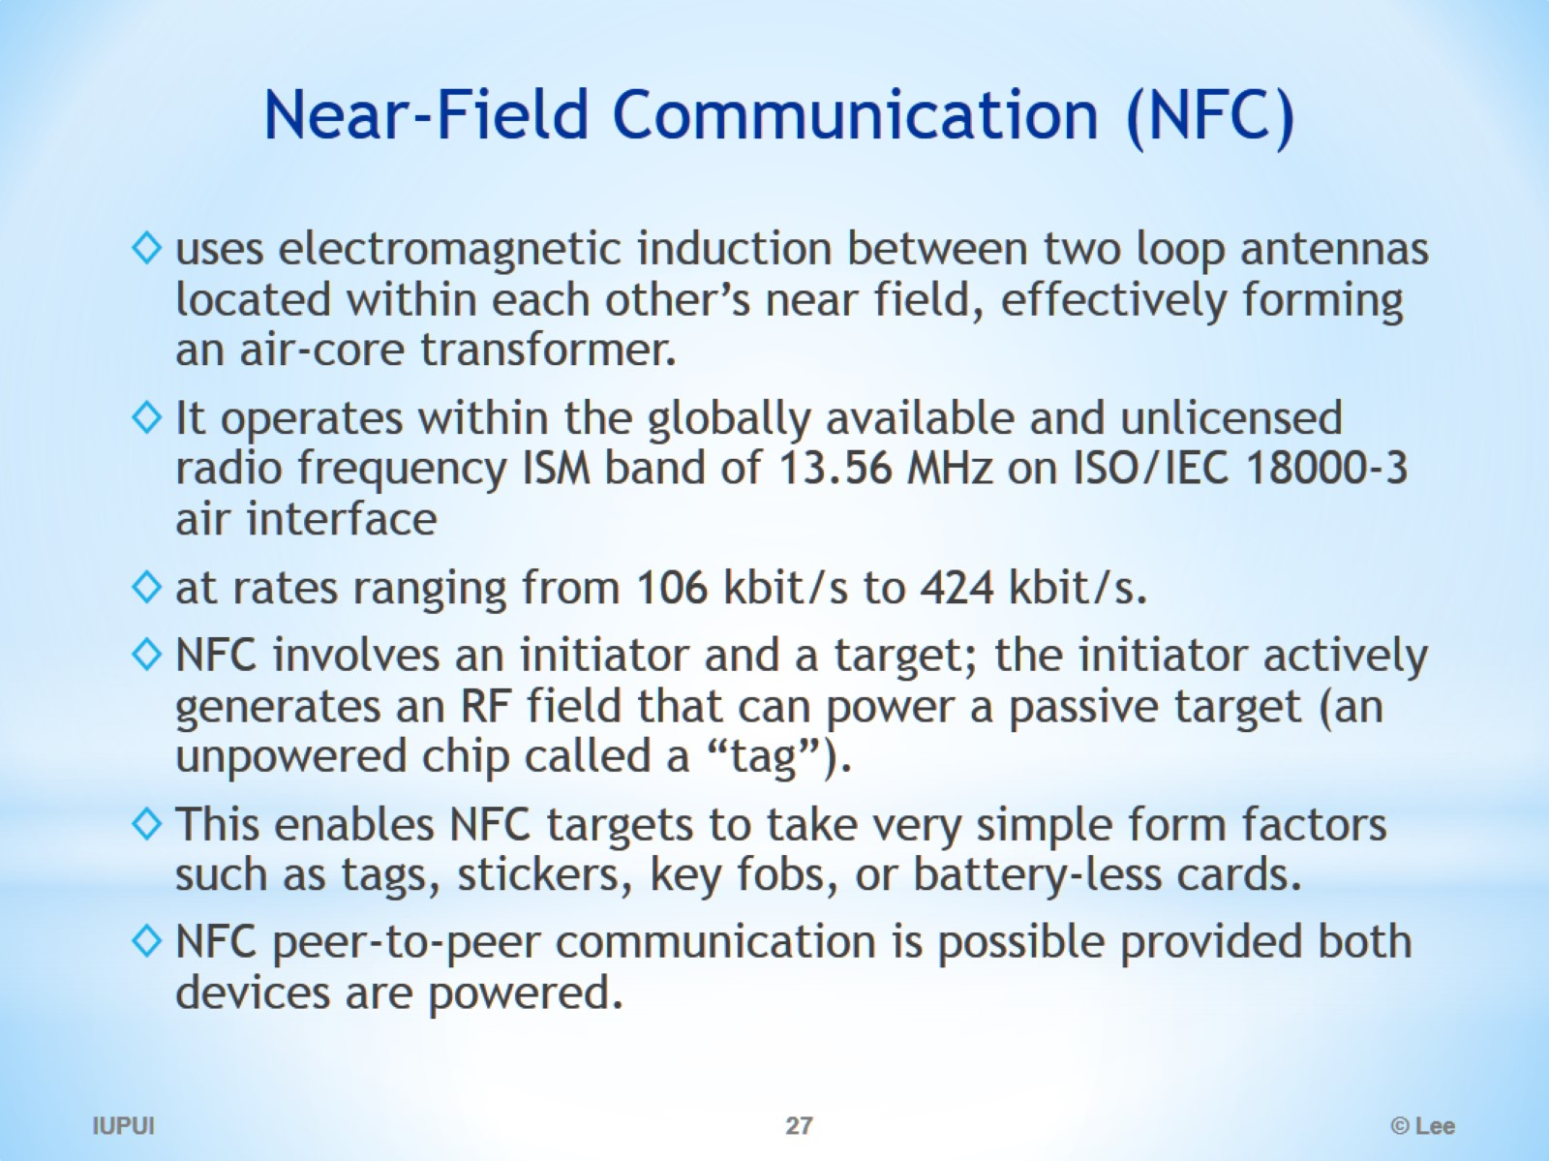
Near-Field Communication (NFC)

Slide 28
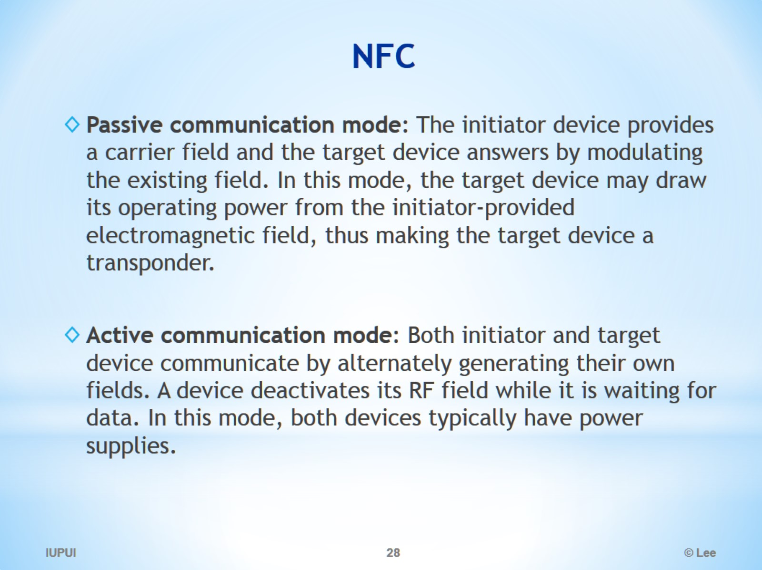
NFC

Slide 29
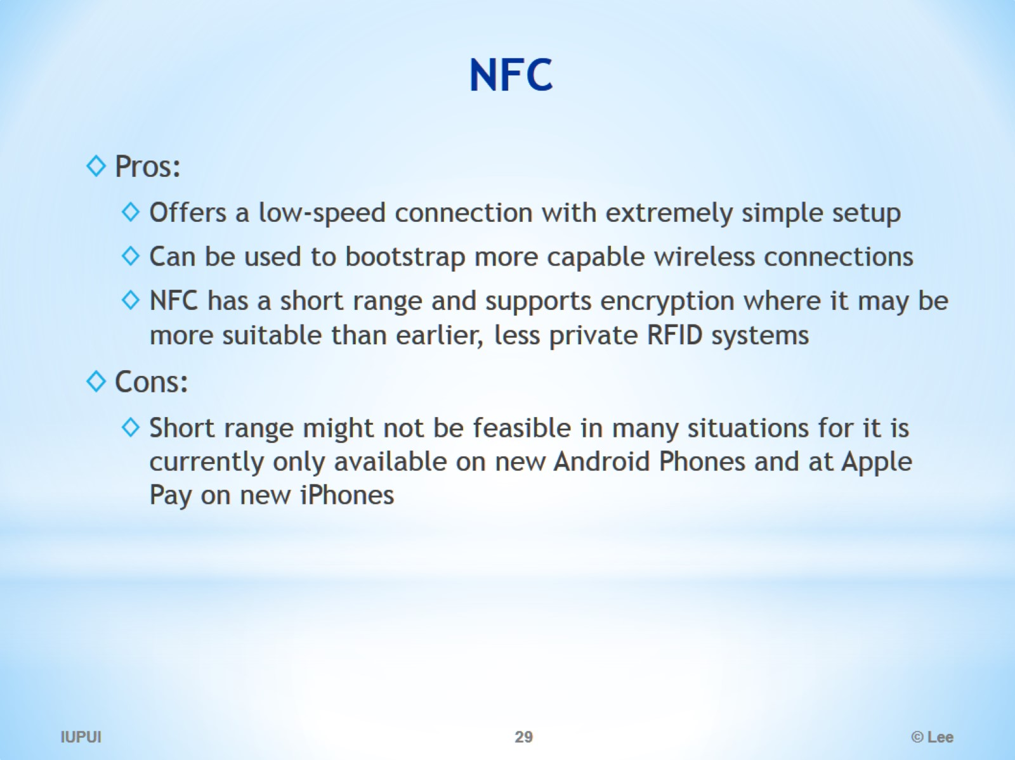
NFC

Slide 30
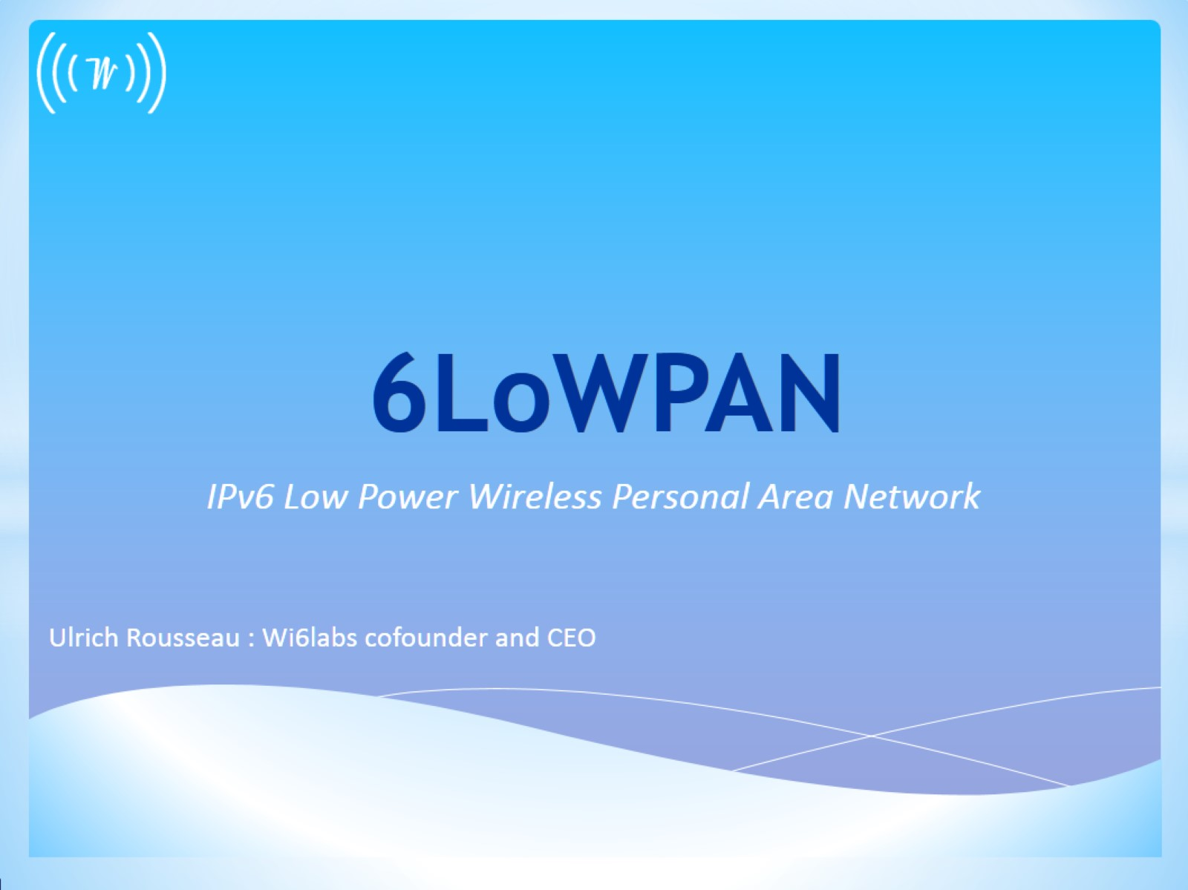
6LoWPAN

Slide 31
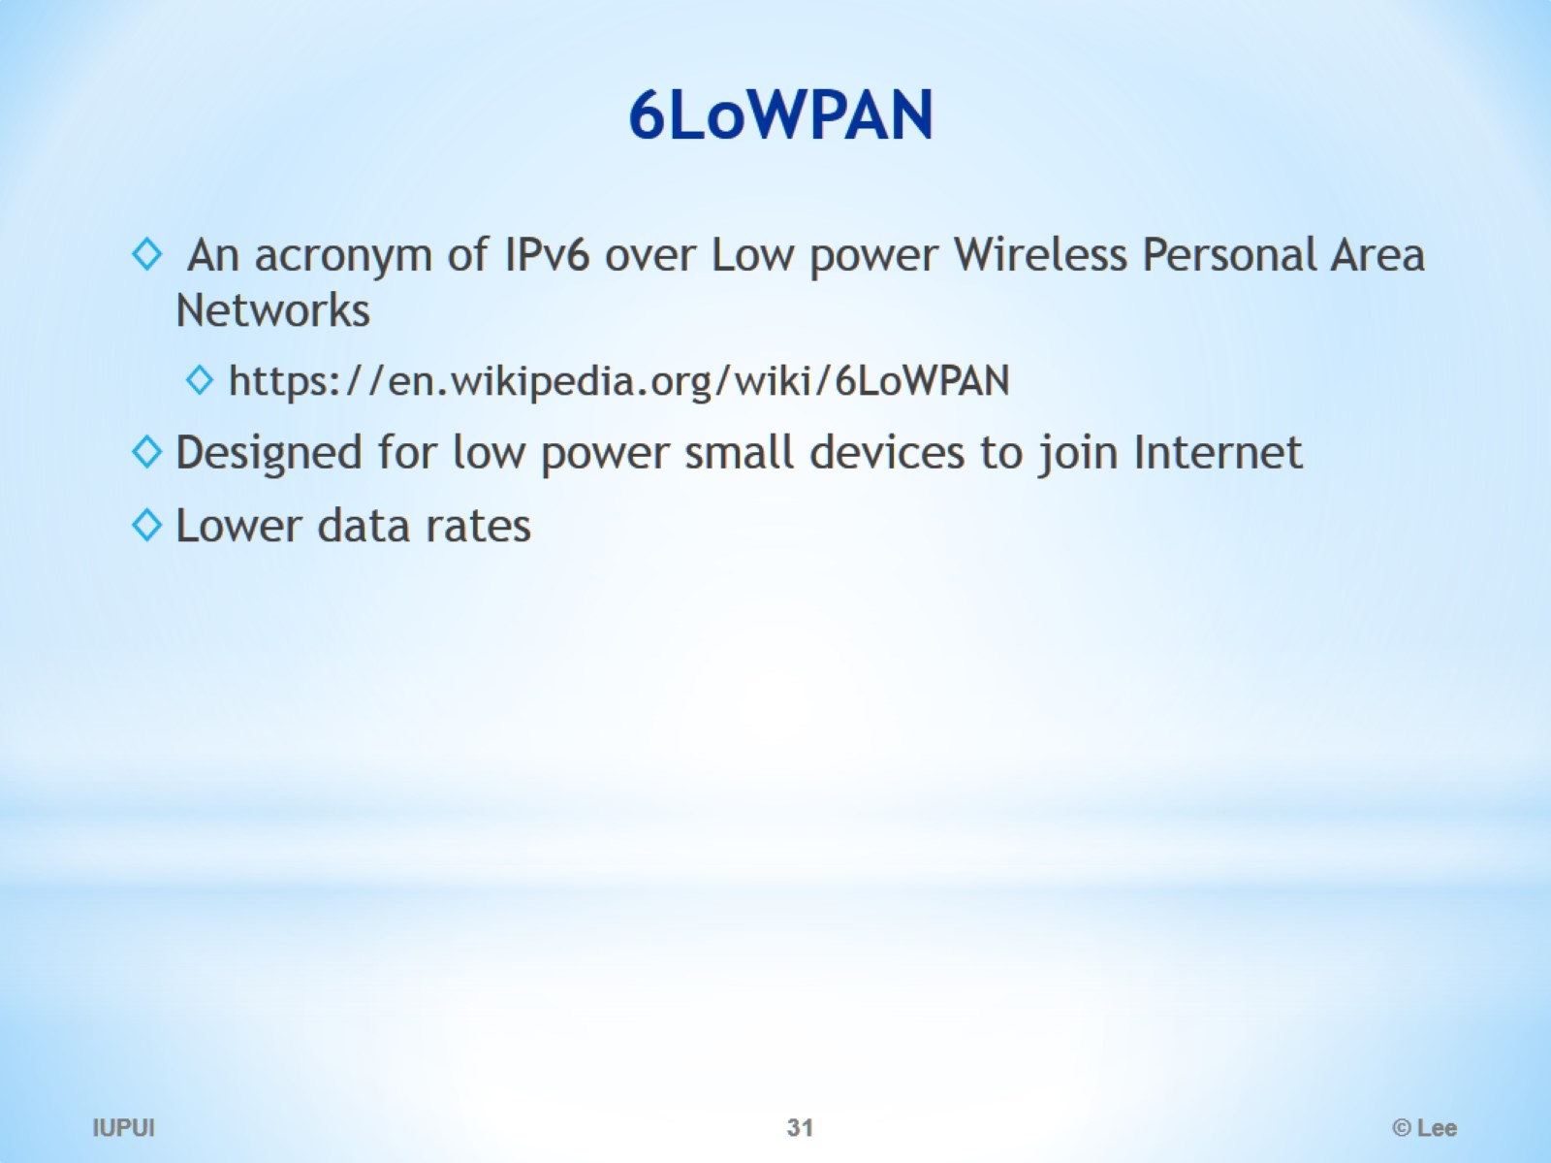
6LoWPAN

Slide 32
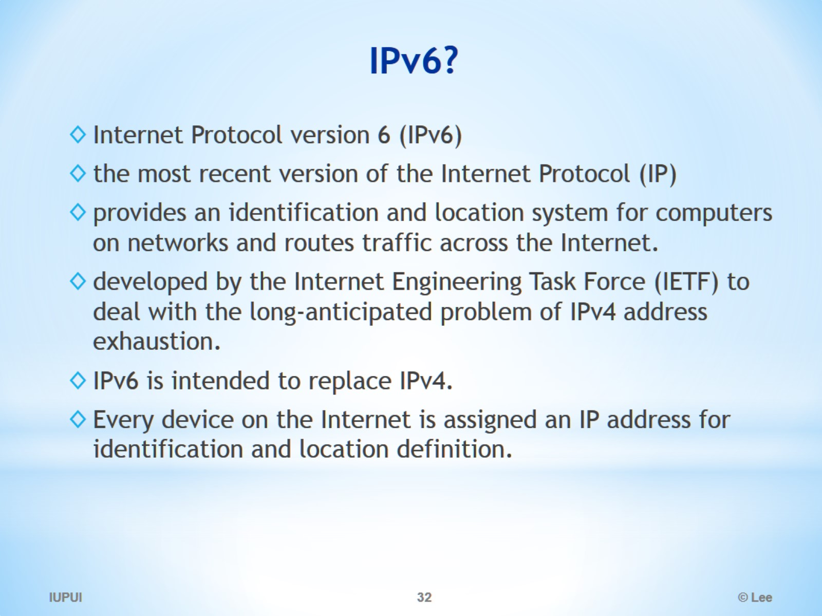
IPv6?

Slide 33
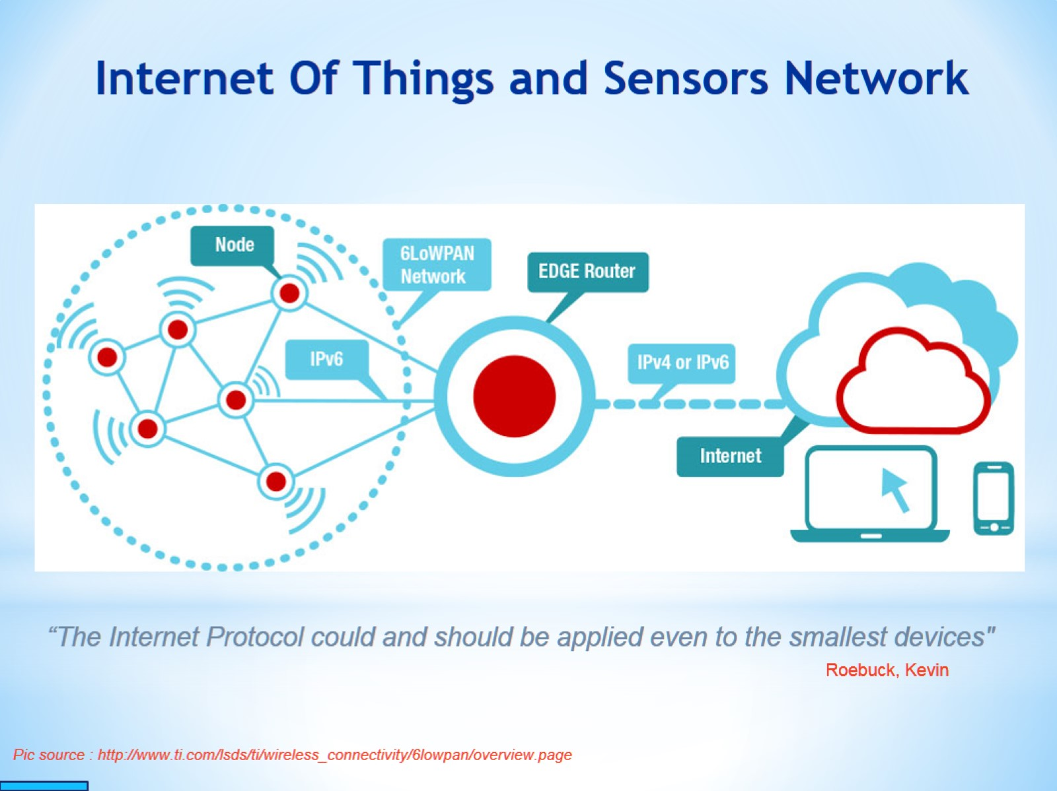
Internet Of Things and Sensors Network

Slide 34
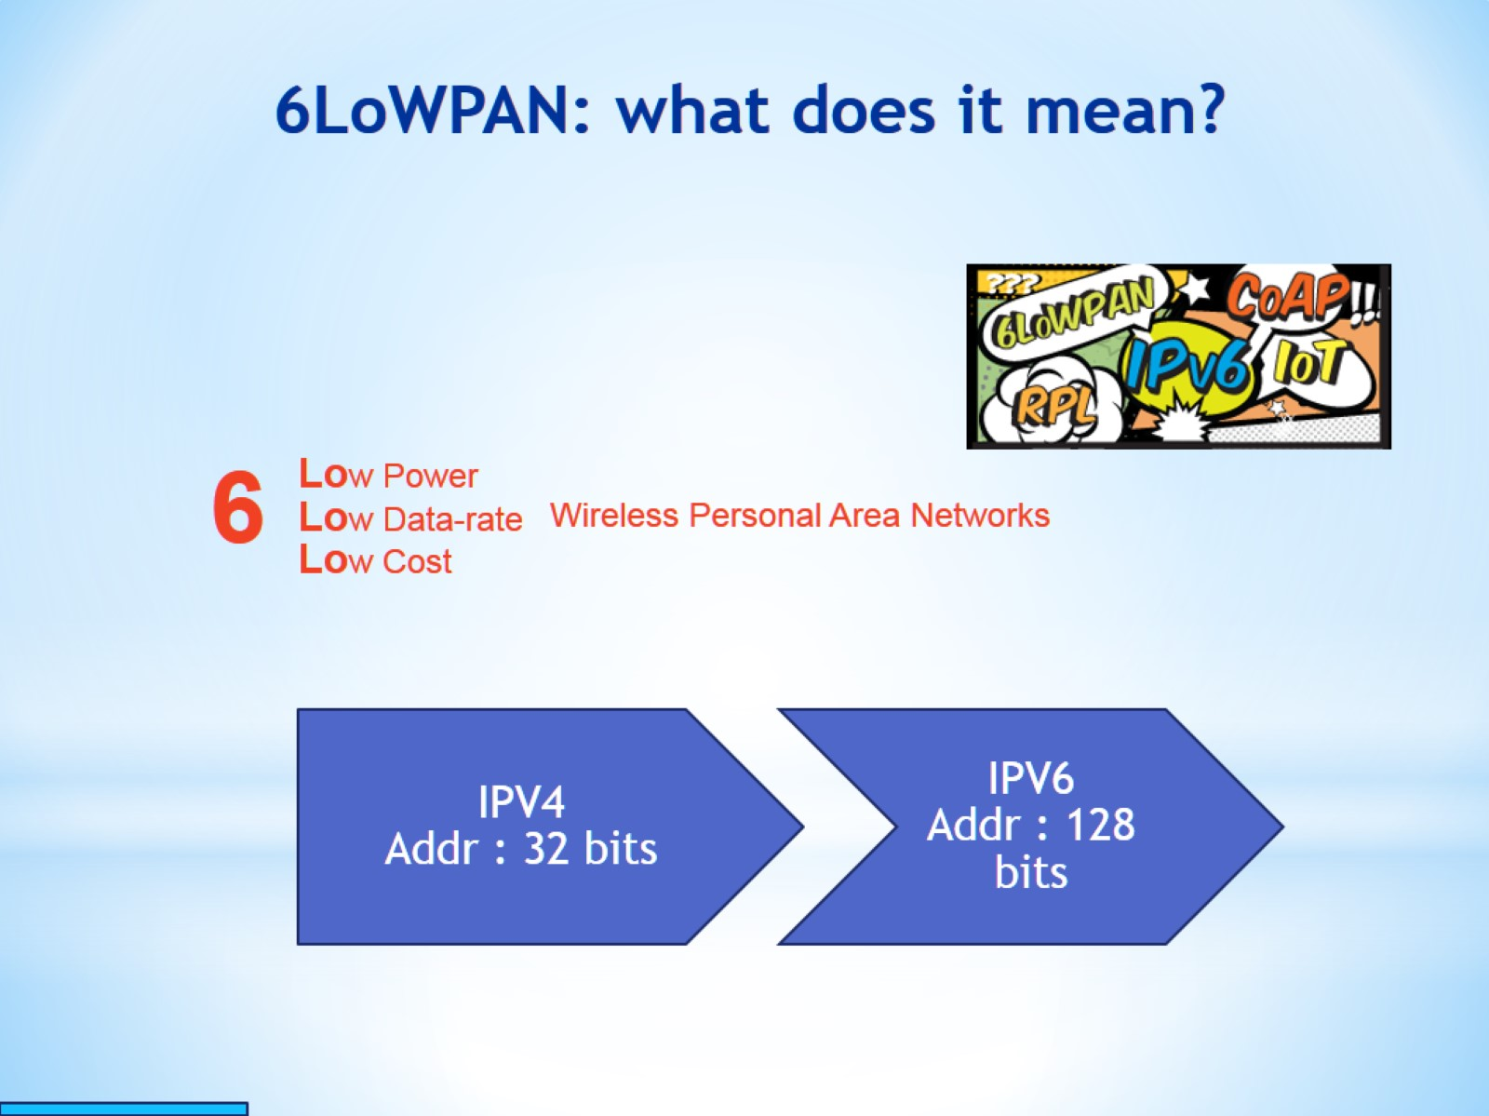
6LoWPAN: what does it mean?

Slide 35
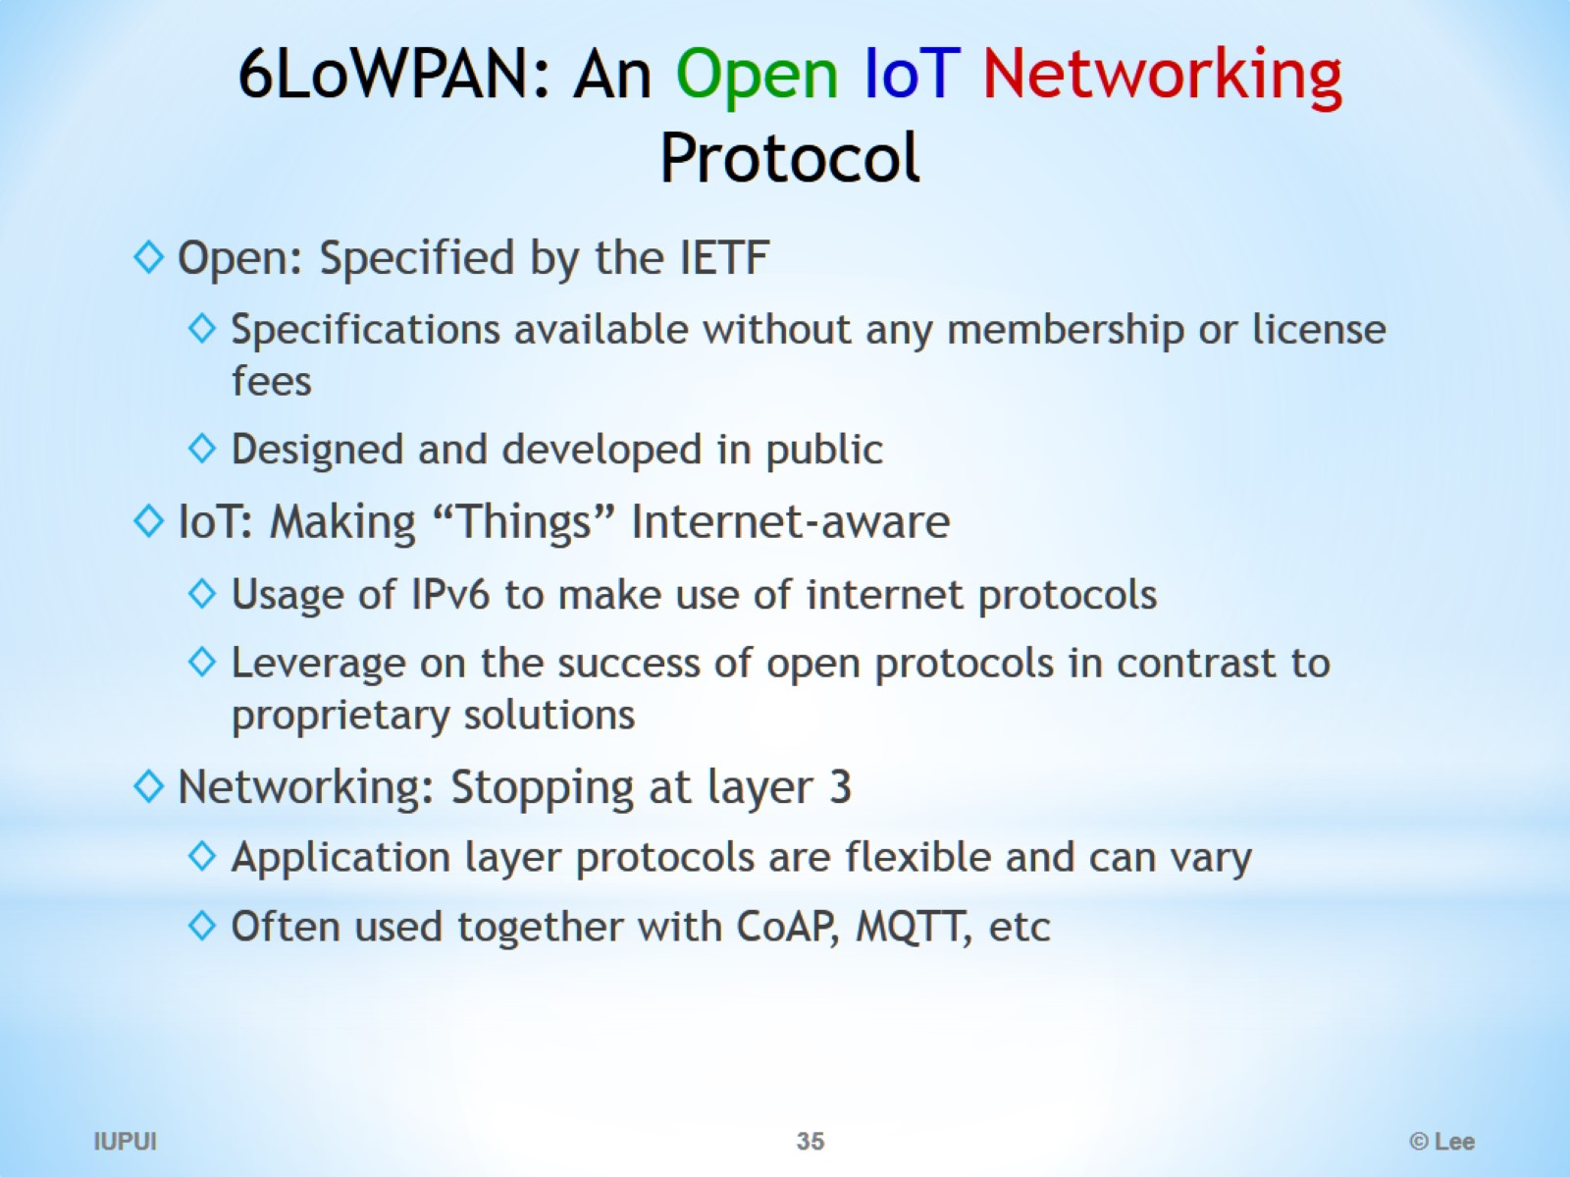
6LoWPAN: An Open IoT Networking Protocol

Slide 36
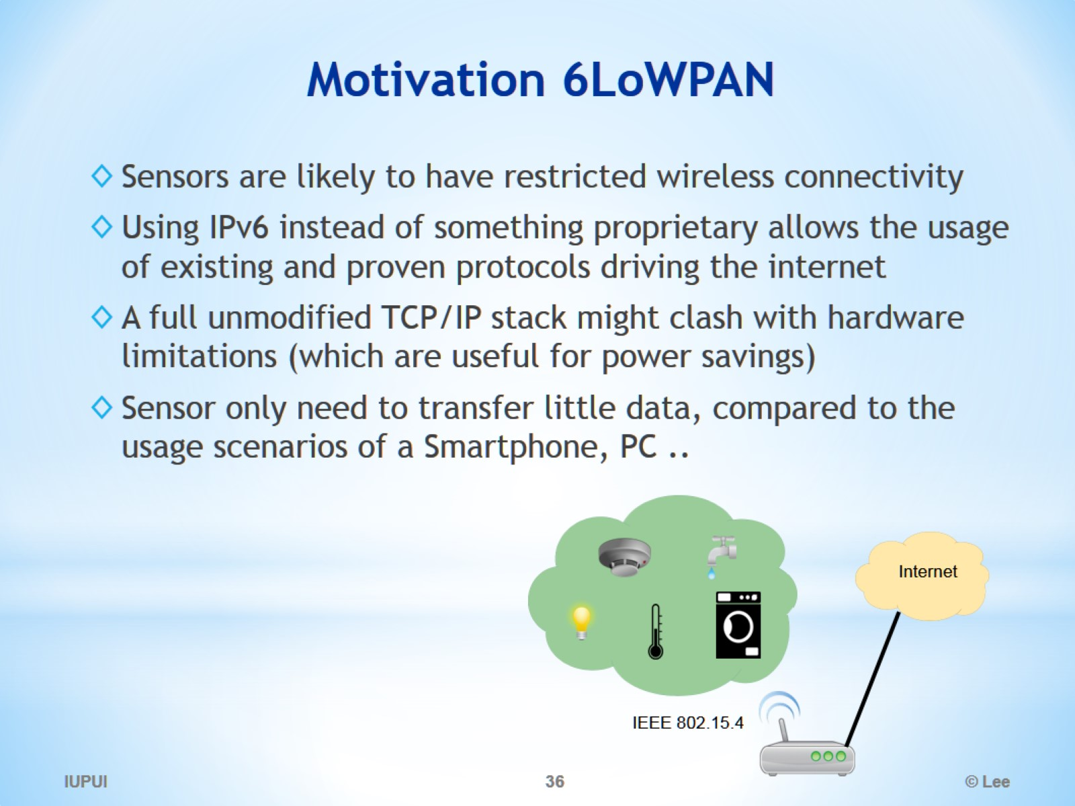
Motivation 6LoWPAN

Slide 37
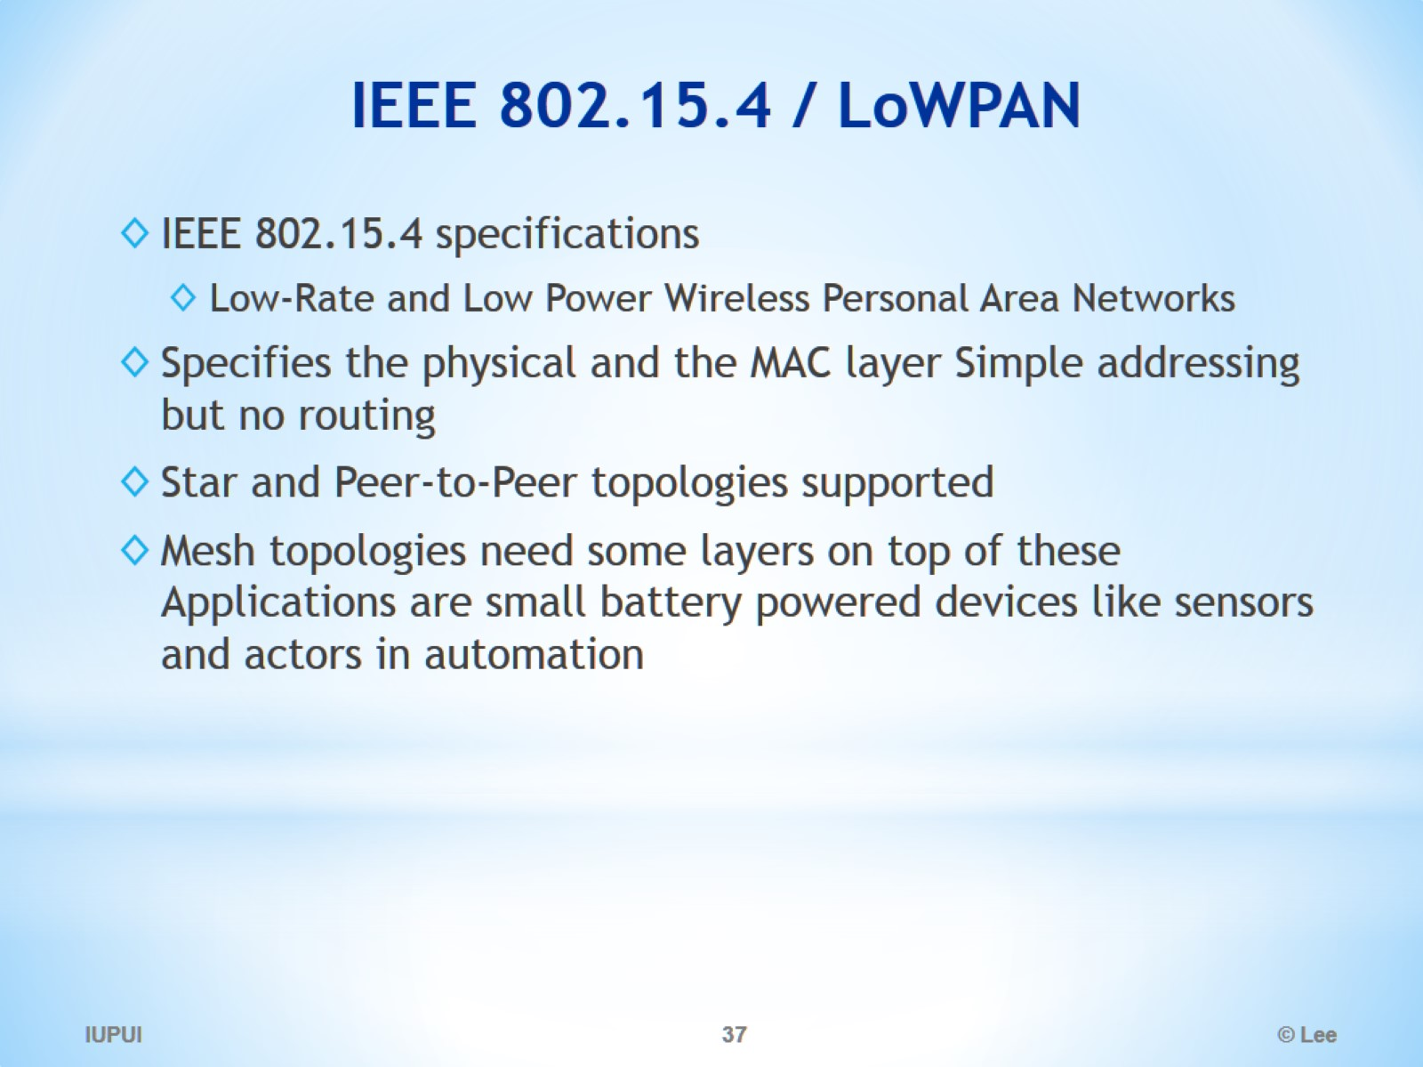
IEEE 802.15.4 / LoWPAN

Slide 38
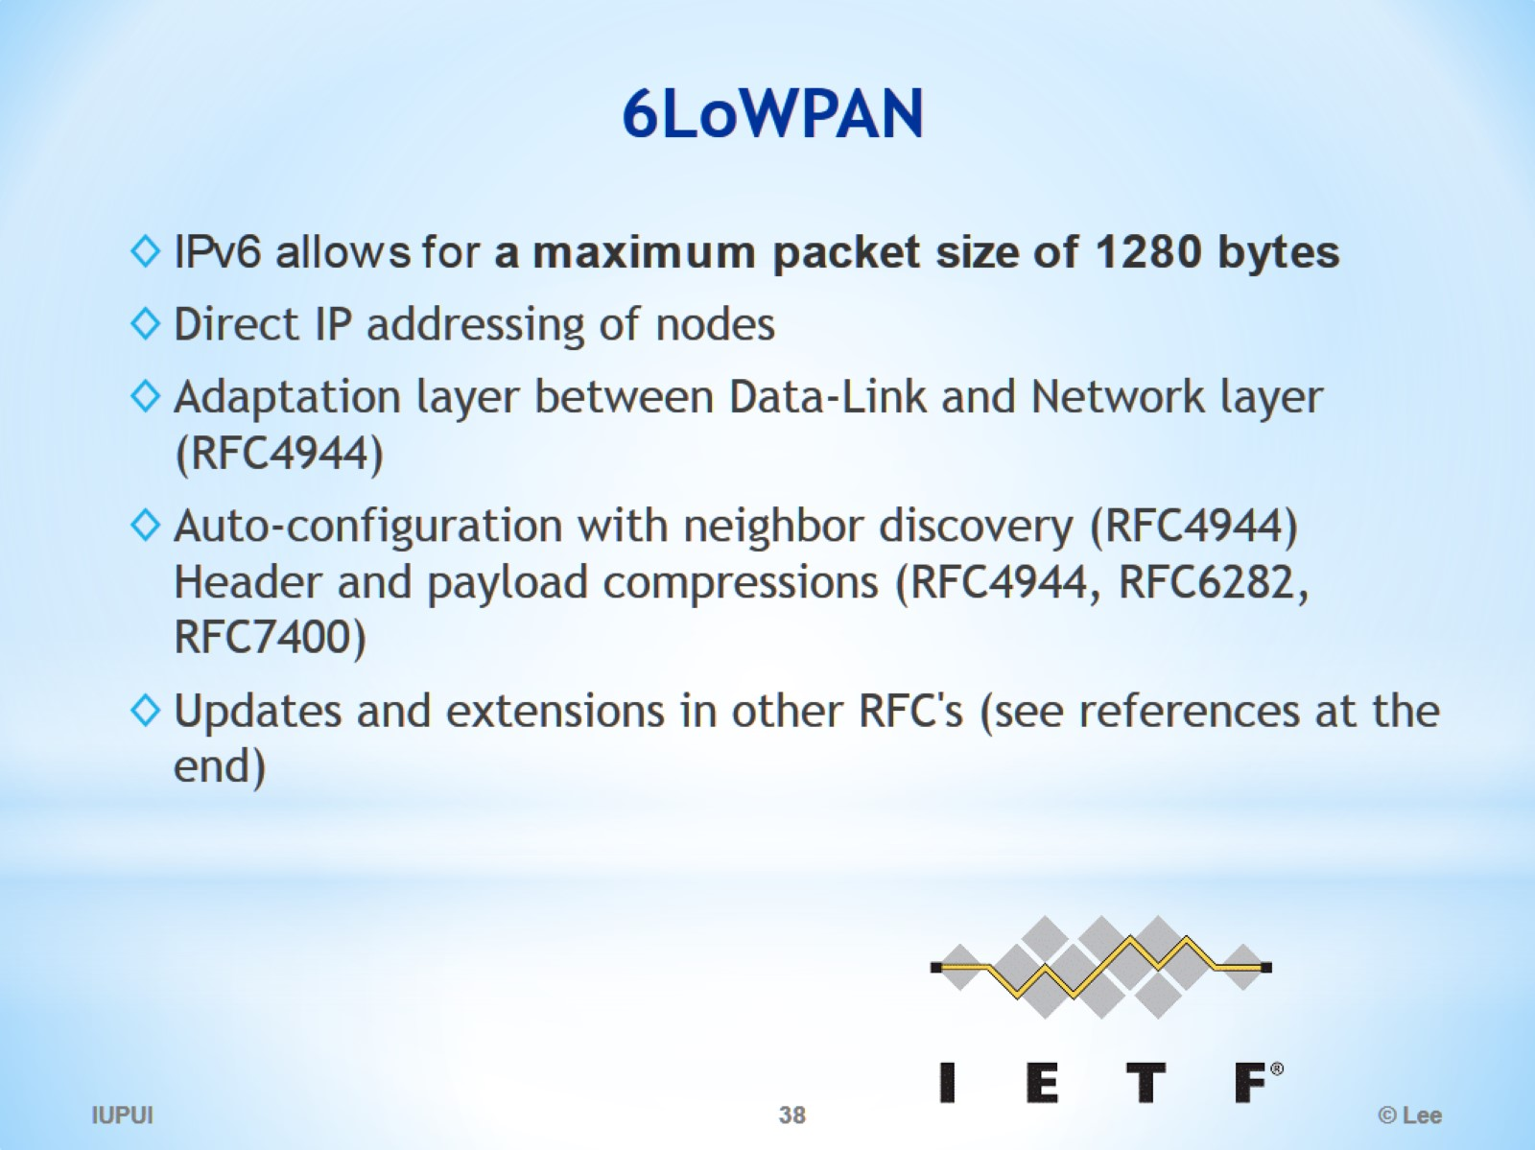
6LoWPAN

Slide 39
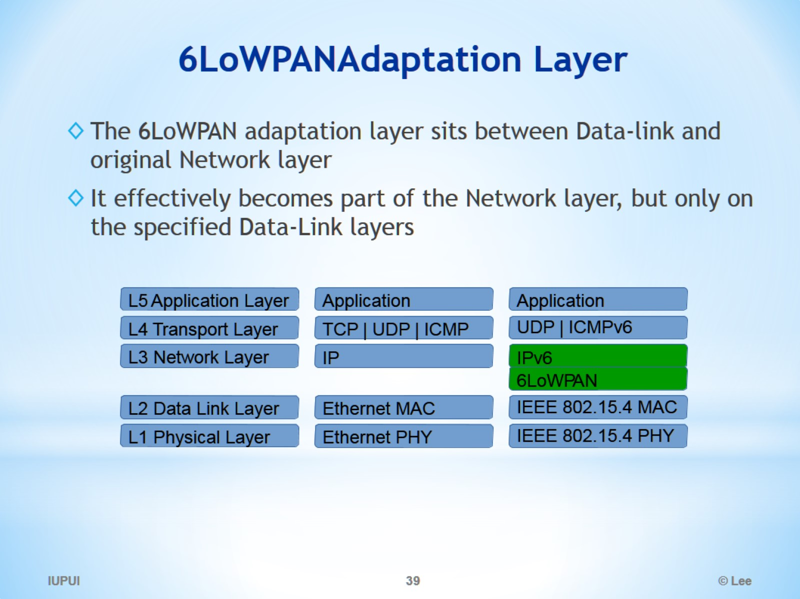
6LoWPAN Adaptation Layer

Slide 40
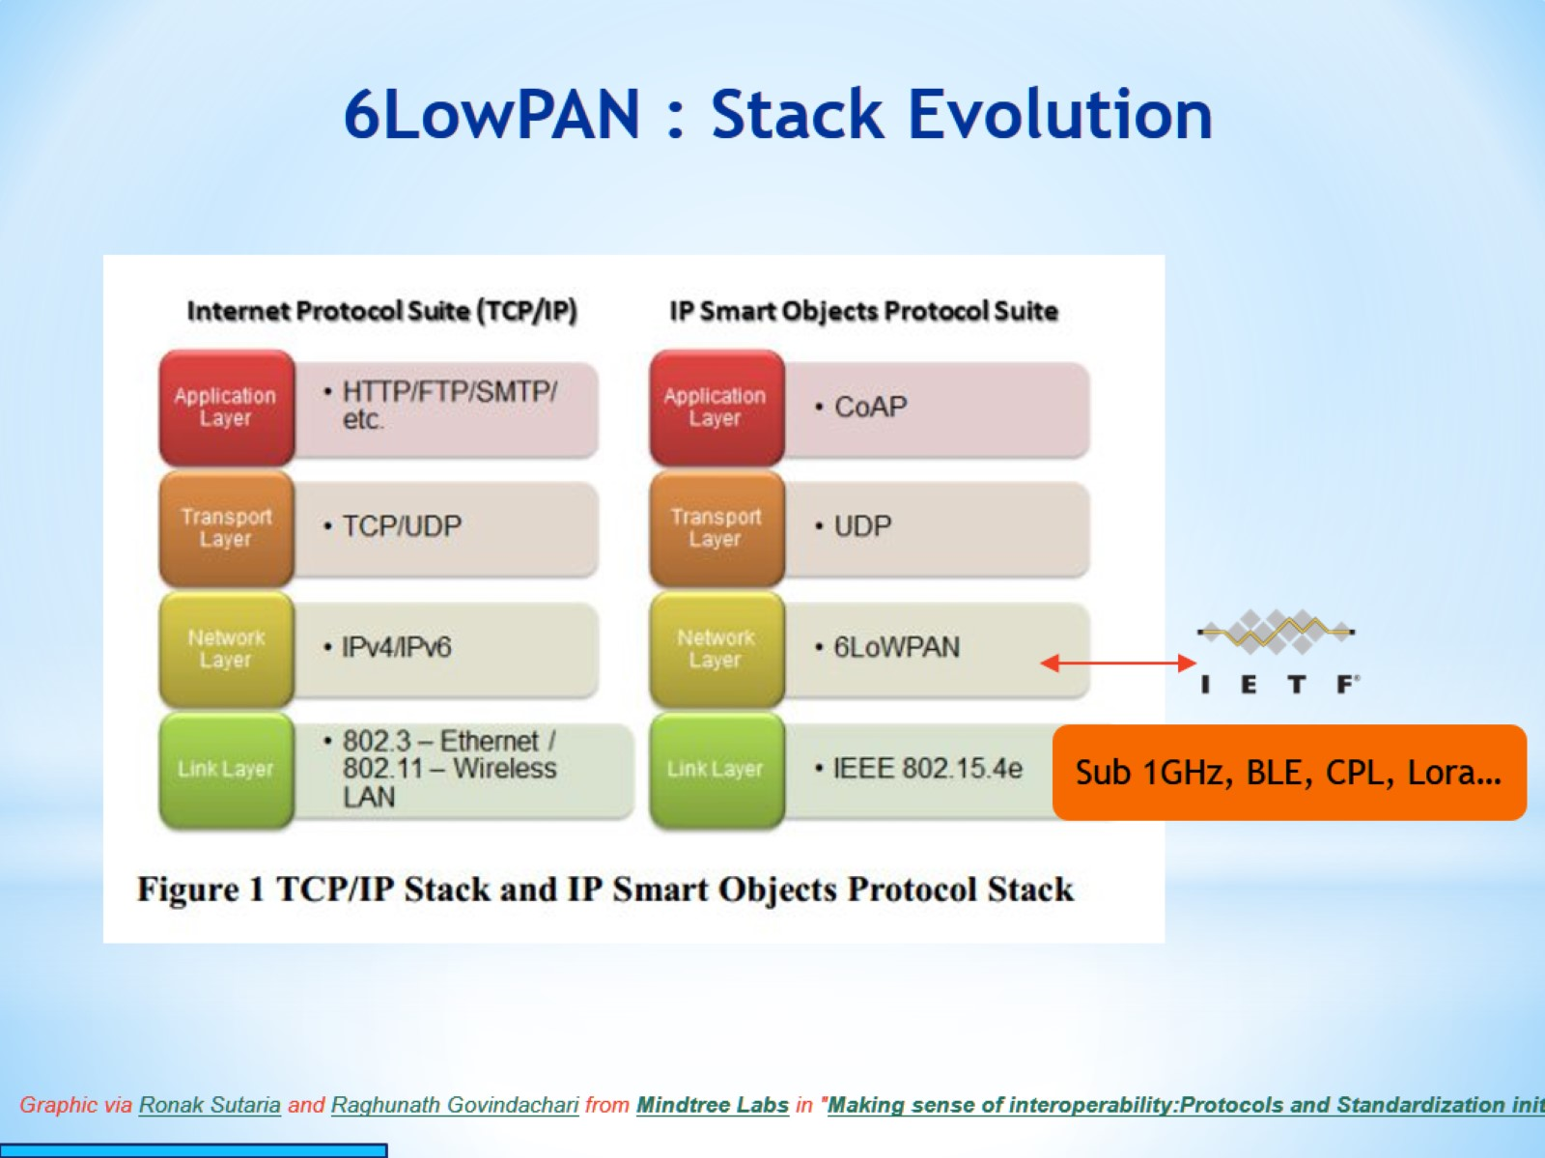
6LowPAN : Stack Evolution

Slide 41
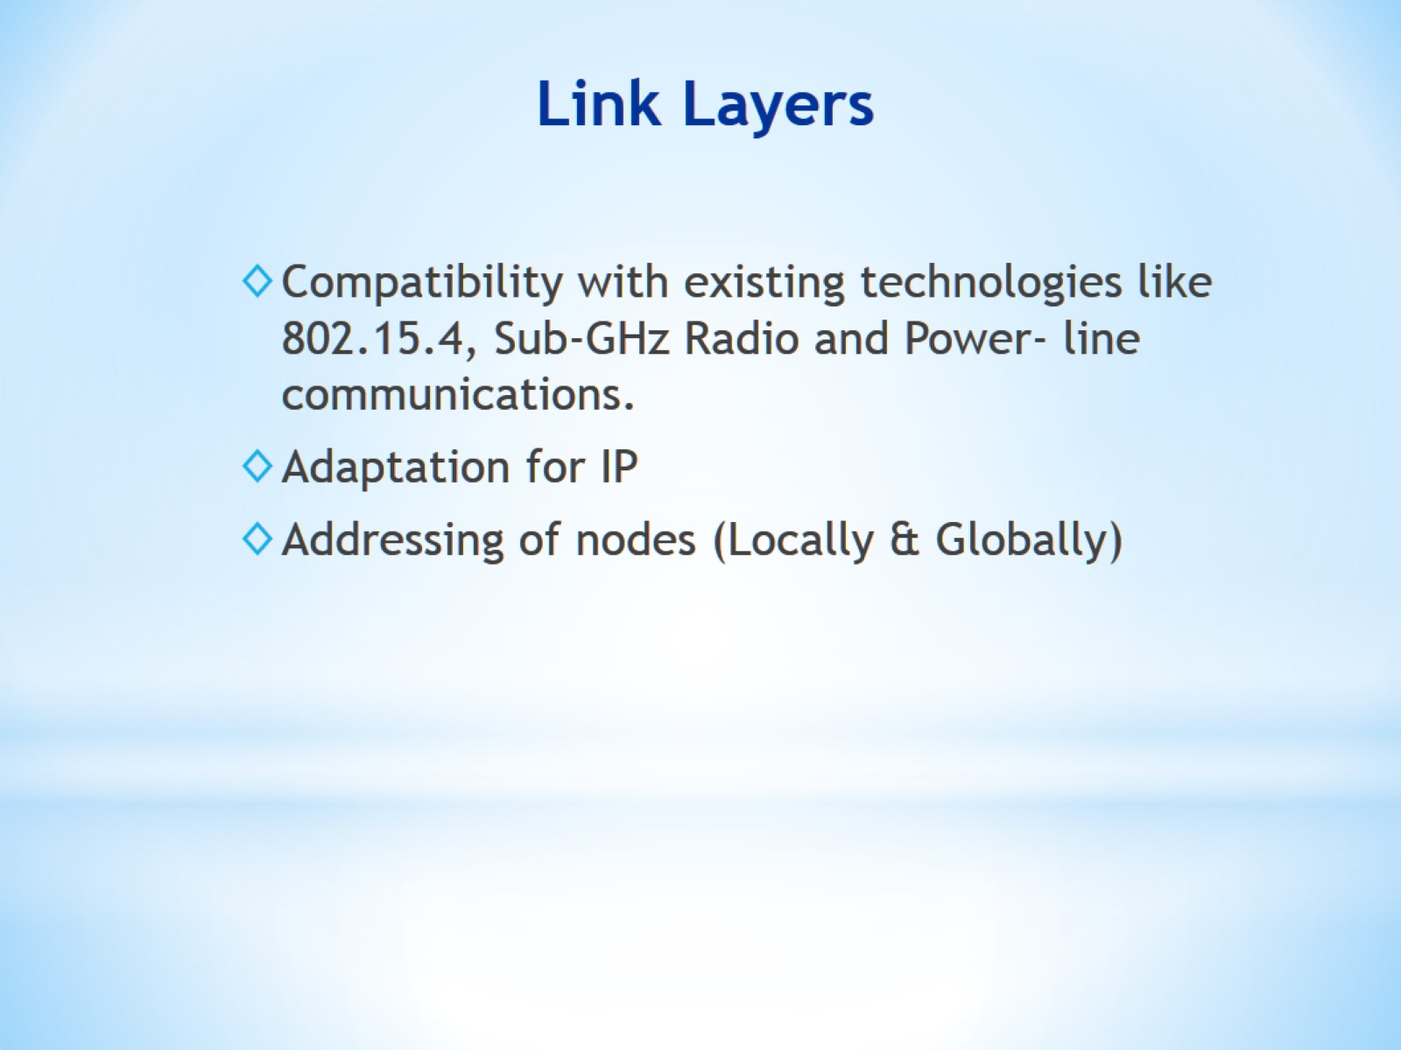
Link Layers

Slide 42
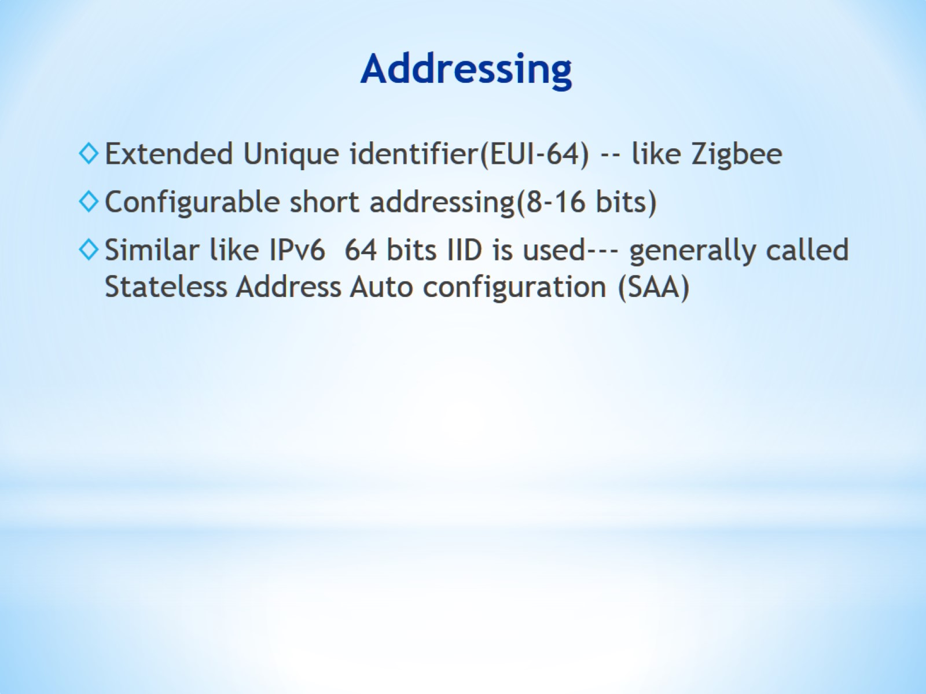
Addressing

Slide 43
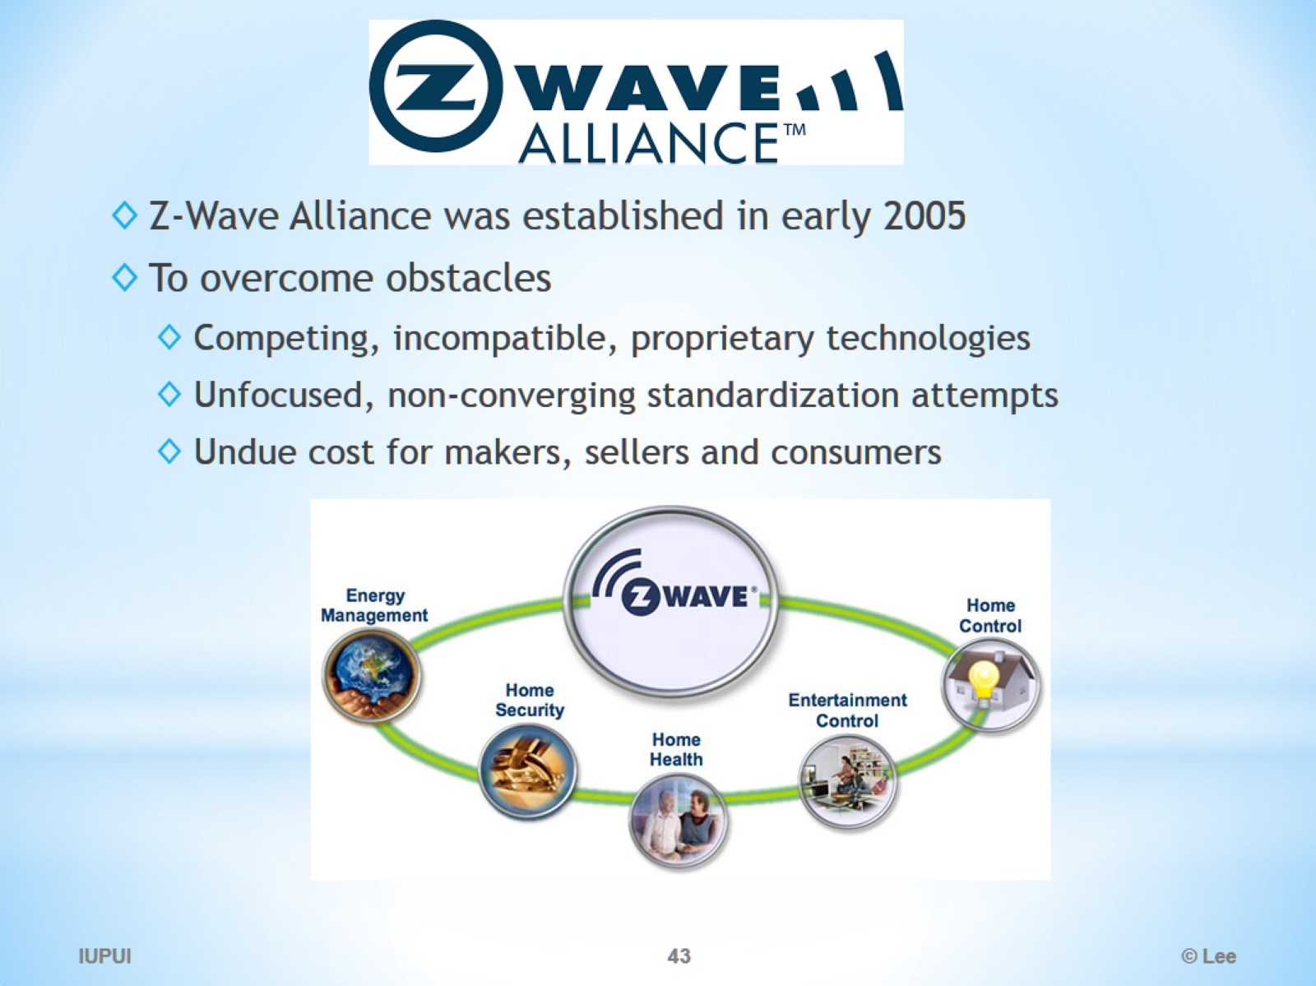
Zwave

Slide 44
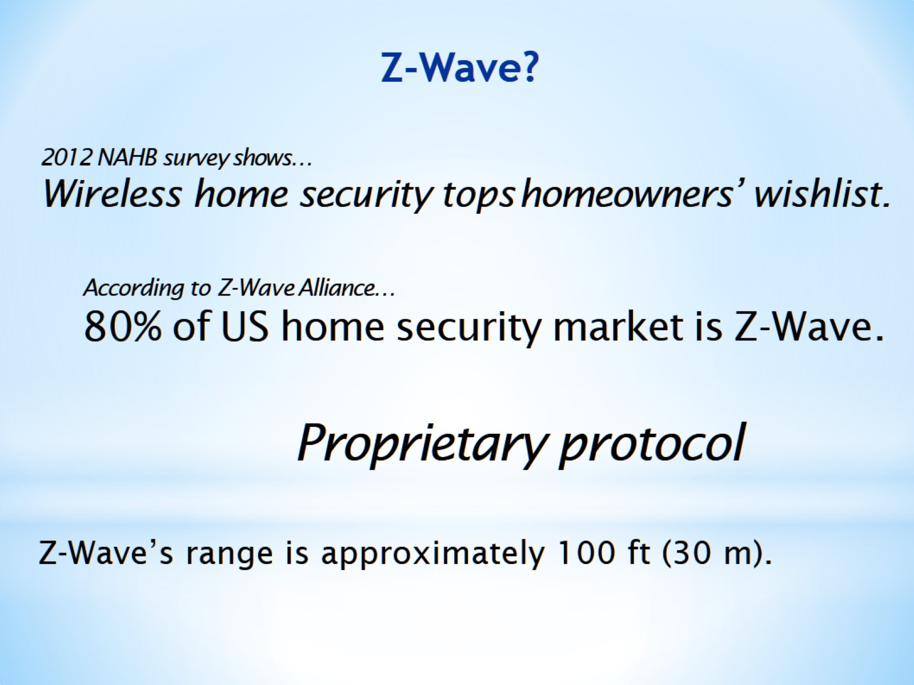
Z-Wave?

Slide 45
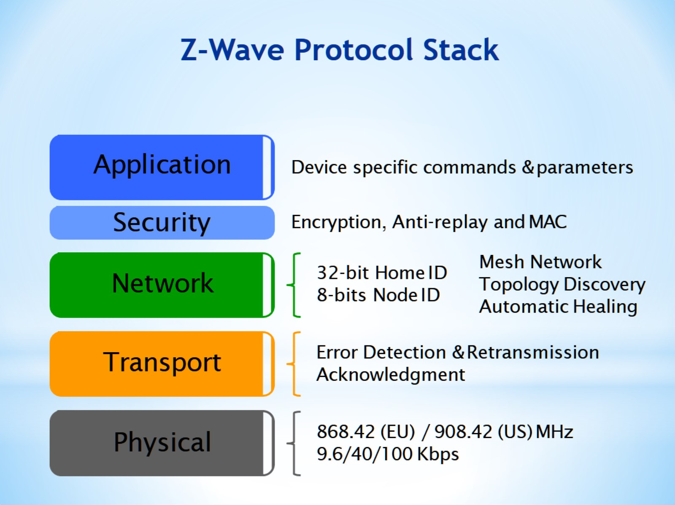
Z-Wave Protocol Stack

Slide 46
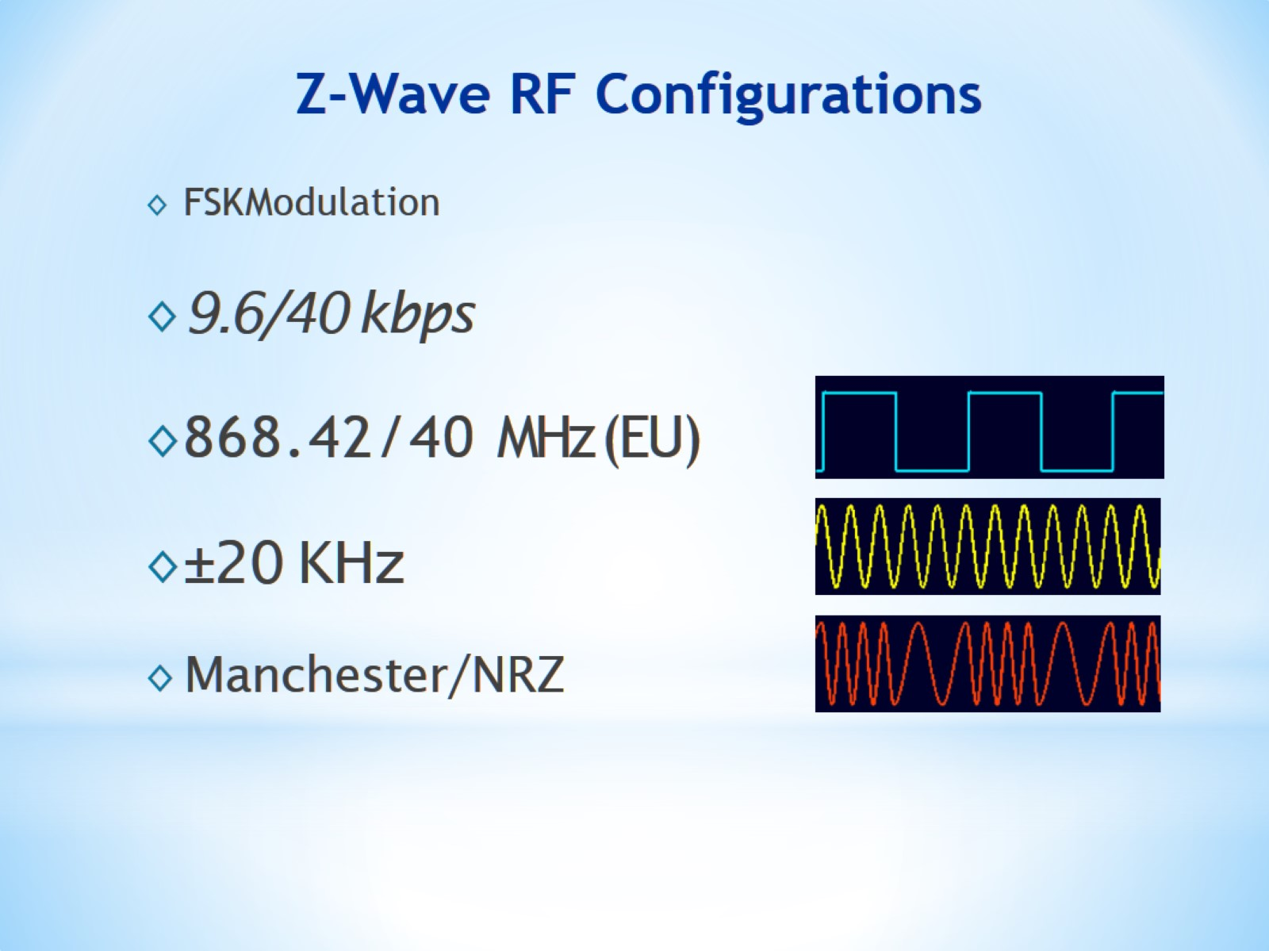
Z-Wave RF Configurations

Slide 47
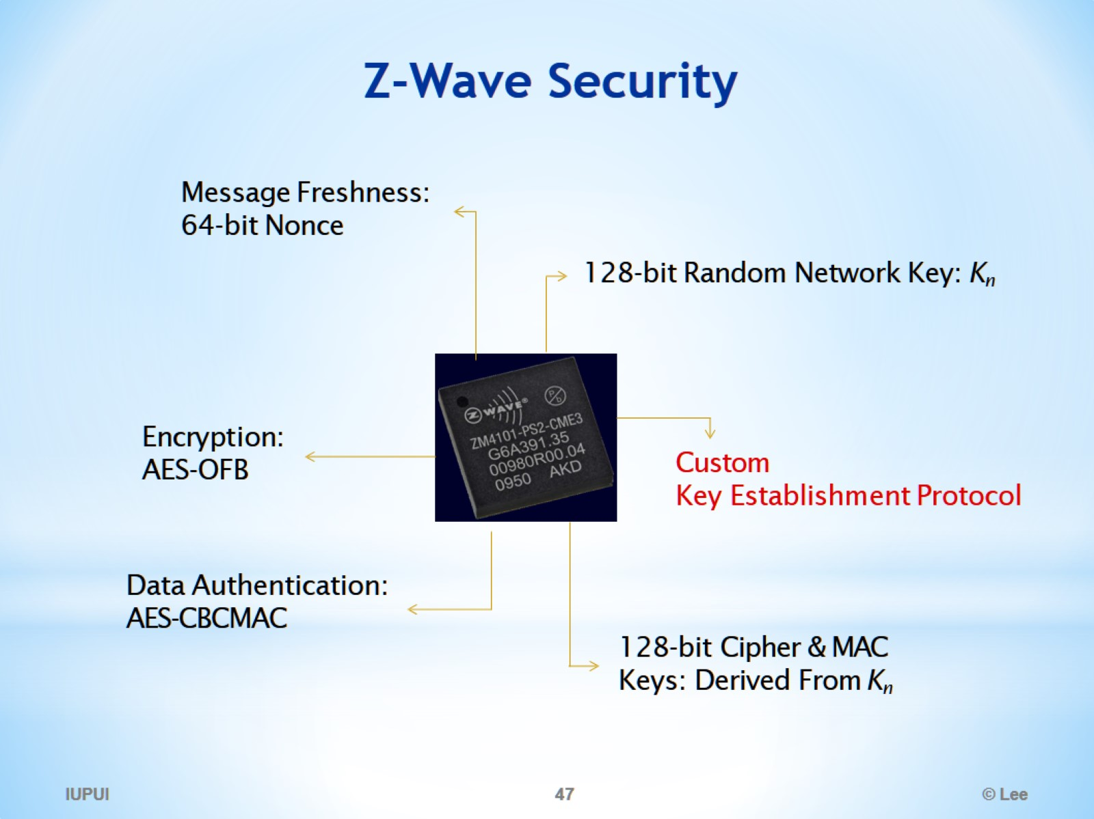
Z-Wave Security

Slide 48
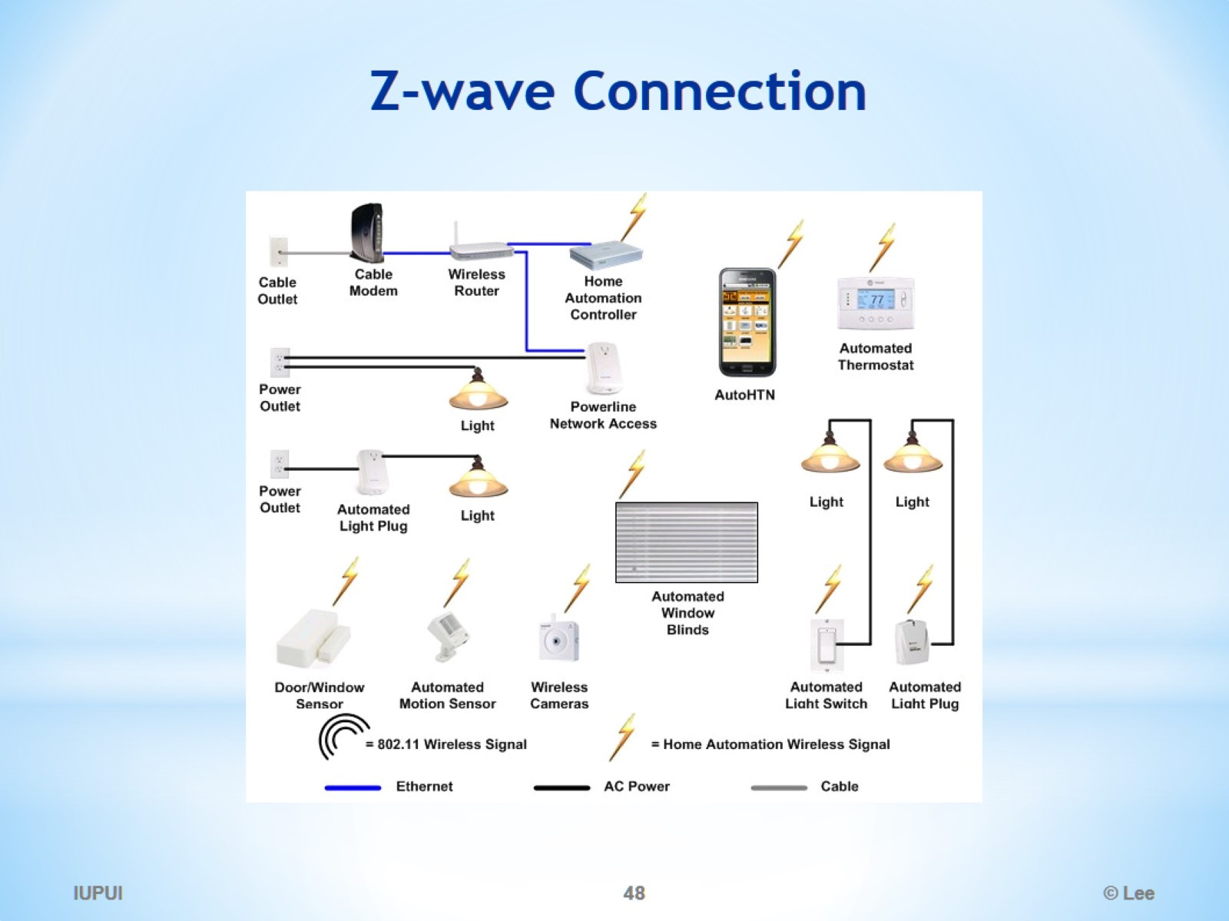
Z-wave Connection

Slide 49
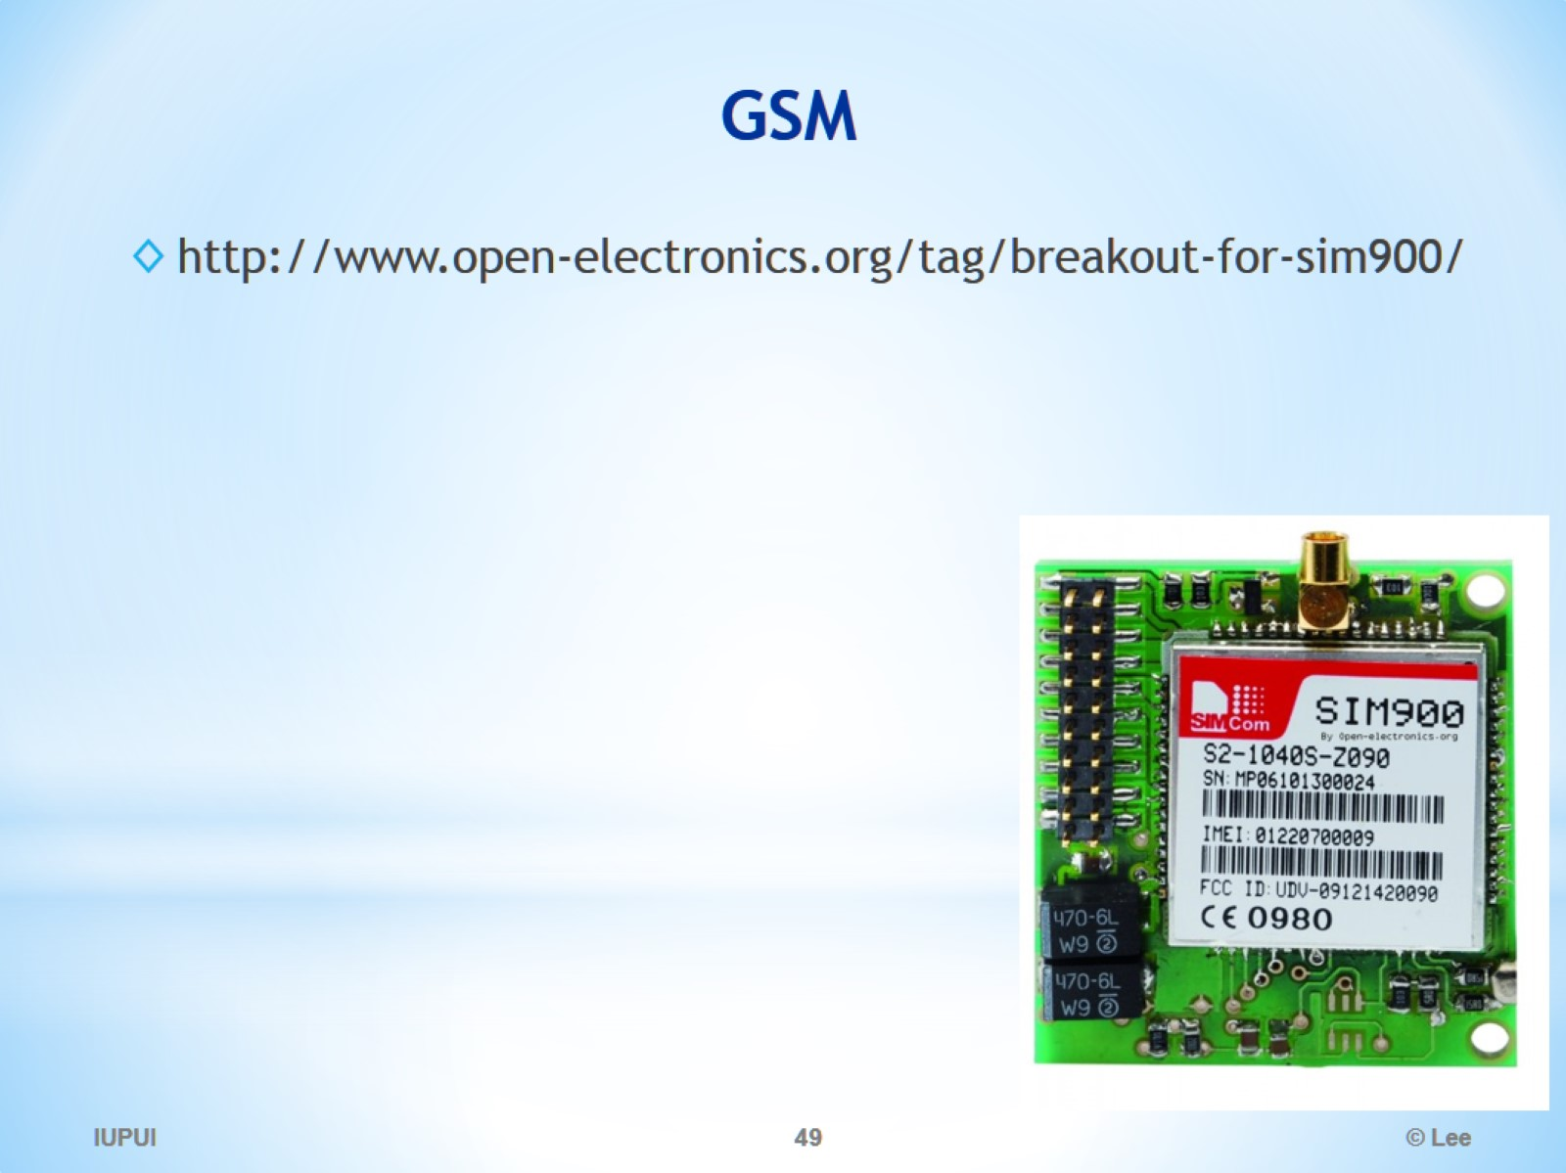
GSM

